Slide 1

Database Technology
MySQL

Slide 2
Index
Topic
How would you explain a database in three sentences to a child?
What is Relation and Relationship?
What is a database management system?
What is a relational database management system?
What is database?
What is data?
DBMS and RDBMS
What is Entity Relationship Diagram?
What is Entity?
What is Entity Type?
What is an Attribute?
What is an Prime, Non-Prime Attribute?

Slide 3
Index
Topic
Entity Relationship Diagram Symbols.
Common relationships
What is Data Modeling?
What is Schema?
SQL Structured Query Language
Login to MySQL
SHOW DATABASES
Information Functions
Source Command
Show Columns
Show Tables
Show Tables Status

Slide 4
Index
Topic
Explain
SELECT statement…
Column - ALIAS
Column - EXPRESSIONS
Identifier Qualifiers
Control Flow Functions
Date and Time Functions
Date and Time Formats
String Functions
Mathematical Functions
SELECT statement… syntax
ORDER BY Clause

Slide 5
Index
Topic
WHERE Clause
SELECT … expressions
GROUP BY Clause
HAVING Clause
Row Limiting Clause
User-Defined Variables
Rownum
Prepared SQL Statement
SELECT ... INTO
SELECT ... INTO var_list
SELECT ... INTO OUTFILE
SELECT ... INTO DUMPFILE

Slide 6
Index
Topic
Sub-Queries
JOINS
USING and ON clause
Set Operation in SQL
CREATE TABLE ... LIKE STATEMENT
CREATE TEMPORARY TABLE ... LIKE STATEMENT
CREATE TABLE ... SELECT STATEMENT
Commit and Rollback
INSERT ROWS using VALUES
INSERT ROWS using SET
INSERT ROWS using SELECT
REPLACE using VALUES

Slide 7
Index
Topic
REPLACE using SET
REPLACE using SELECT
Single-table UPDATE
Multiple-table UPDATE
Single-Table DELETE
Multiple-table DELETE
Datatypes
JSON Datatype
CREATE TABLE
CONSTRAINTS
INFORMATION_SCHEMA

Slide 8
Index
Topic

Slide 9
Class Room
Session 1

Slide 10
How would you explain a database to a child?

Slide 11

Explain a database in three sentences.
You know, how you have to put your toys away after playing, so you can find them easily the next time you want to play with them?
A database is like a shelf to put your toys away, assume the toys are data instead.
Now, the database can always find the right data easily - whether it's "all the outdated toys" or "all the yellow toys," the computer can get / fetch everything very quickly, as it is stored in database.

Slide 12

MySQL
MySQL is the most popular Open Source
Relational Database Management System.
MySQL was created by a Swedish company - MySQL AB that was founded in 1995. It was acquired by Sun Microsystems in 2008; Sun was in turn acquired by Oracle Corporation in 2010.

Slide 13
What is Relation and Relationship?

Slide 14
What is Relation and Relationship?
Relation: In Database, a relation represents a table or an entity than contain attributes.
Relationship: In database, relationship is that how the two entities are connected to each other, i.e. what kind of relationship type they hold between them.
Primary/Foreign key is used to specify this relationship.

Slide 15

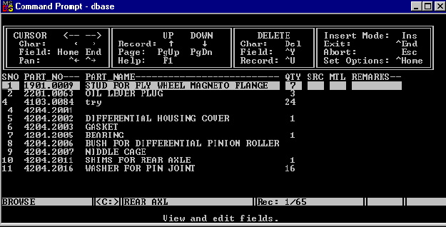

What is a database management system?

Slide 16
What is a database management system?
A database management system (DBMS) is software for creating and managing databases. The DBMS provides users and programmers with a systematic way to create, retrieve, update and manage data.
DBMS
It supports Single User only
Not Secured
No Relationship (PK/FK)

Slide 17

What is a relational database management system?

Slide 18



relational database management system?
A relational database management system (RDBMS) is a database management system (DBMS) that is based on the relational model.
RDBMS supports
client/server Technology
Highly Secured
Relationship (PK/FK)

Slide 19
properties of relational table
Relational tables have six properties:
Values are atomic.
Column values are of the same kind.
Each row is unique.
The sequence of columns is insignificant.
The sequence of rows is insignificant.
Each column must have a unique name.

Slide 20
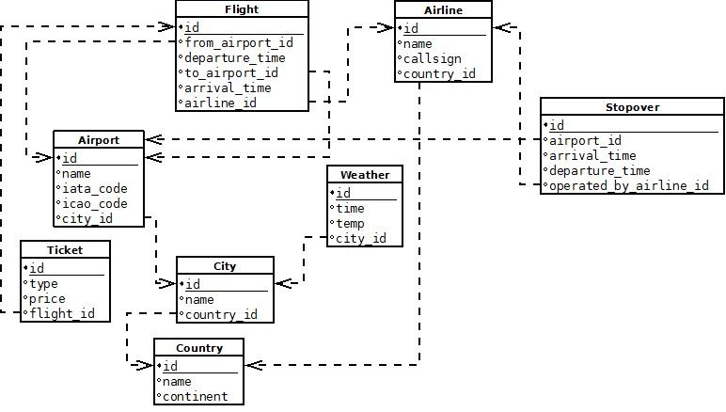

Slide 21

A database application is a computer program whose primary purpose is entering and retrieving information.
What is database?

Slide 22

What is Database?
A database is a system to organize, store and retrieve large amounts of data easily, which is stored in one or more data files by one or more users.
Each database is a collection of tables, which are called relations, hence the name "relational database".
Index Page

Slide 23

What is data?

Slide 24

What is Data?
Data is any facts, number, text, symbol, images, audio or video that can be recorded and that can be processed by a computer.
Data can be in the form of Text or Multimedia

Slide 25
DBMS and RDBMS

Slide 26
Difference between DBMS and RDBMS?
DBMS | RDBMS
DBMS applications store data as file. | RDBMS applications store data in a tabular form.
Normalization is not present in DBMS. | Normalization is present in RDBMS.
DBMS does not apply any security with regards to data manipulation. | RDBMS defines the integrity constraint for the purpose of ACID (Atomocity, Consistency, Isolation and Durability) property.
DBMS uses file system to store data, so there will be no relation between the tables. | in RDBMS, data are stored in the form of tables, so a relationship between these data will be stored.
DBMS does not support distributed database. | RDBMS supports distributed database.
Examples of DBMS are file systems, xml etc. | Example of RDBMS are mysql, postgre, sql server, oracle etc.

Slide 27
ACID properties of transactions
Atomicity. In a transaction involving two or more separate pieces of information, either all of the pieces are committed or none are.
Consistency. A transaction either creates a new and valid state of data, or, if any failure occurs, returns all data to its state before the transaction was started.
Isolation. A transaction in process and not yet committed must remain isolated from any other transaction.
Durability. Committed data is saved by the system such that, even in the event of a failure and system restart, the data is available in its correct state.

Slide 28
What is Entity Relationship Diagram?

Slide 29
Entity Relationship Diagram (ER Diagram)
Use E-R model to get a high-level graphical view to describe the "ENTITIES" and their "RELATIONSHIP"

Slide 30
Entity Relationship Diagram (ER Diagram)
The basic constructs of ER Model are
Entity, Attributes and Relationships.

Slide 31
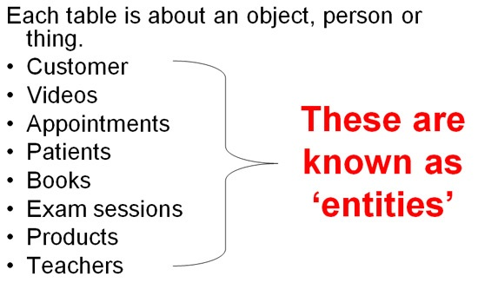
An entity can be a real-world object.
What is Entity?

Slide 32
Entity
In relation to a database , an entity is a person, place, or thing about which data can be stored.
e.g., in a school database, students, teachers, classes, and courses can be considered as entities.
All these entities have some attributes or properties that give them their identity.
Every entity has its own characteristics.

Slide 33
What is Entity Type?

Slide 34
Entity type
The entities that have the common attributes is called an entity type.
Each entity type in the database is described by a name and a list of attributes.
e.g. an entity Person is an entity type that has Age, Name and Address attributes.
Eg.
Entity TYPE Entity
Person (Age, Name, Address ,. . .) 17 , Sharmin, Paud Road, …

Slide 35

When you are designing attributes for your entities, you will sometimes find that an attribute does not have a value for every instance of the entity. For example, you might want an attribute for a person's middle name, but you can't require a value because some people have no middle name. For these occasions, you can define the attribute so that it can contain null values.
What is an Attribute?
Entity
In some cases, you might not want a specific attribute to contain a null value, but you don't want to require that the user or program always provide a value. In this case, a default value might be appropriate. A default value is a value that applies to an attribute if no other valid value is available.
Attribute

Slide 36
Attributes
A table has rows and columns
In RDBMS, a table organizes data in rows and columns. The COLUMNS are known as ATTRIBUTES / FIELDS whereas the ROWS are known as RECORDS / TUPLE.
In Relation: EMP
Attributes
SSN | EmployeeName | Job | Hiredate | Salary
1 | KING | PRESIDENT | 2017-02-15 | 5000
… | … | … | … | …
… | … | … | … | …
… | … | … | … | …
Rows

Slide 37
Attributes
In Entity Relationship(ER) Model attributes can be classified into the following types.
Simple/Atomic and Composite Attribute
Single Valued and Multi Valued attribute
Stored and Derived Attributes
Complex Attribute

Slide 38
Attributes
Simple / Atomic Attribute --VS-- Composite Attribute
(Can’t be divided further) (Can be divided further)
Single Value Attribute --VS-- Multi Valued Attribute
(Only One value) (Multiple values)
Stored Attribute --VS-- Derived Attribute
(Only One value) (Virtual)
Complex Attribute
(Composite & Multivalued)

Slide 39
Composite VS Multi Valued Attribute

Slide 40
Composite / Multi Valued Attributes
Composite Attribute
Person Entity
Name attribute: FirstName, MiddleName, and LastName
PhoneNumber attribute: CountryCode, CityCode, and PhoneNumber
Multi Valued Attribute
Person Entity
Hobbies attribute: reading, hiking, hockey, skiing, photography.
SpokenLanguages attribute: Hindi, Marathi, Gujarati, English.

Slide 41
What is an Prime, Non-Prime Attribute?

Slide 42
Attributes
Prime attribute
An attribute, which is a part of the prime-key, is known as a prime attribute.
Non-prime attribute
An attribute, which is not a part of the prime-key, is said to be a non-prime attribute.

Slide 43
Entity Relationship Diagram Symbols

Slide 44
Entity Relationship Diagram Symbols
Attribute
Composite Attribute
Key Attribute
Strong Entity
Weak Entity
Derived Attribute
Weak Relationship
Relationship
Multivalued Attribute

Slide 45
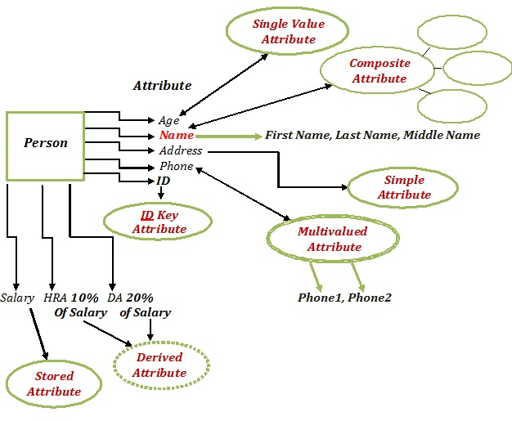
Entity Relationship Diagram

Slide 46
What is a degree, cardinality, domain, and union in database?
Degree d(R): Total no of attributes/columns present in a relation/table is called degree of the relation and is denoted by d(R).
Cardinality |R|: Total no if tuples present in a relation or Rows present in a table, is called cardinality of a relation and is denoted by |R|.
Domain: Total range of accepted values for an attribute of the relation is called the domain of the attribute. (Data Type)
Union Compatibility: Two relations R and S are set to be Union Compatible to each other if and only if:
They have the same degree d(R).
Domains of the respective attributes should also be same.

Slide 47
What is a domain constraint in database?
Domain Constraint = data type + Constraints (NOT NULL / UNIQUE / PRIMARY KEY / FOREIGN KEY / CHECK / DEFAULT)

Slide 48
What is a domain constraint in database and data integrity?
Domain Constraint = data type + Constraints (NOT NULL / UNIQUE / PRIMARY KEY / FOREIGN KEY / CHECK / DEFAULT)
Data integrity refers to the validity of data, meaning data is consistent and correct. Data integrity is normally enforced in a database system by a series of integrity constraints or rules.
Three types of integrity constraints: entity integrity, referential integrity and domain integrity:
Entity integrity concerns the concept of a primary key.
Referential integrity concerns the concept of a foreign key.
Domain integrity A domain is a set of values of the same type.

Slide 49
Common relationships

Slide 50

Relationships - Binary
The three most common relationships in ER models are
Binary, Unary, and Ternary
A binary relationship is when two entities participate and is the most common relationship.

Slide 51
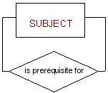
Relationships - Unary
The three most common relationships in ER models are Binary, Unary and Ternary
A unary relationship is when both participants in the relationship are the same entity.

Slide 52
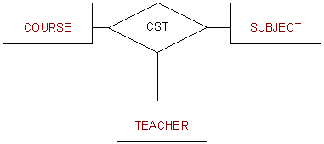
Relationships - Ternary
The three most common relationships in ER models are Binary, Unary and Ternary
A ternary relationship is when three entities participate in the relationship.

Slide 53

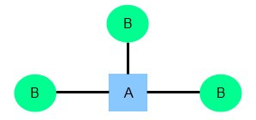
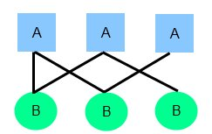
Relationships
There are three degrees of relationship
one-to-one (1:1)
one-to-many (1:M)
many-to-many (M:N)

Slide 54
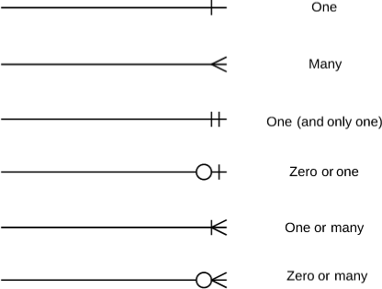
Relationships

Slide 55
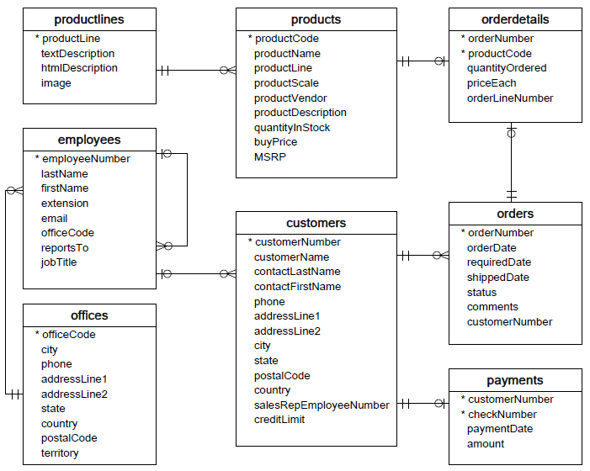

Slide 56
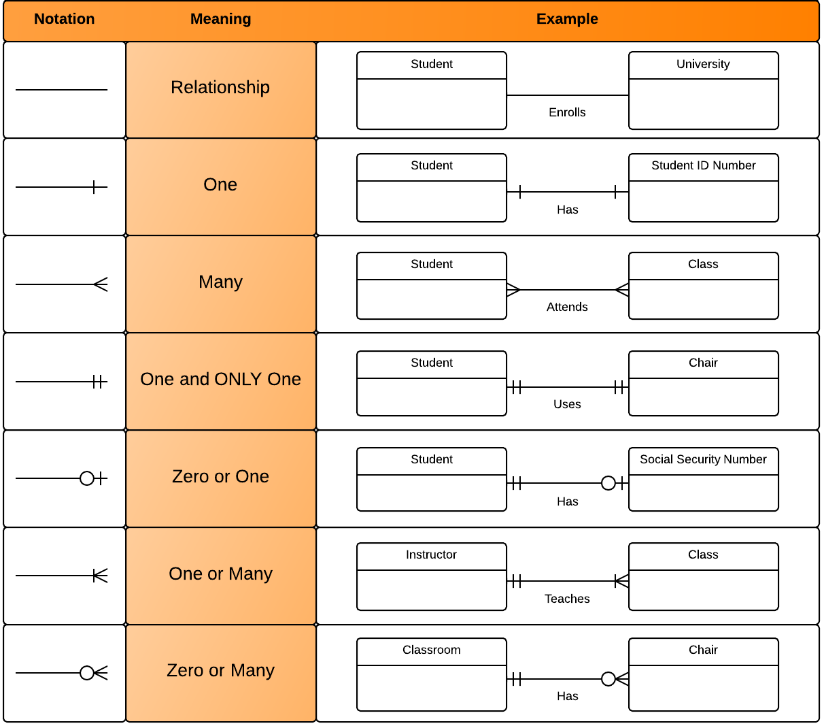
Relationships

Slide 57



one to one Relationships
The employee can manage only one department, and each department can be managed by one employee only.
personID
Name
DOB Gender
Nationality
passportID
personID (not null, unique, and foreign key)
passportNumber issueDate
expireDate

Slide 58

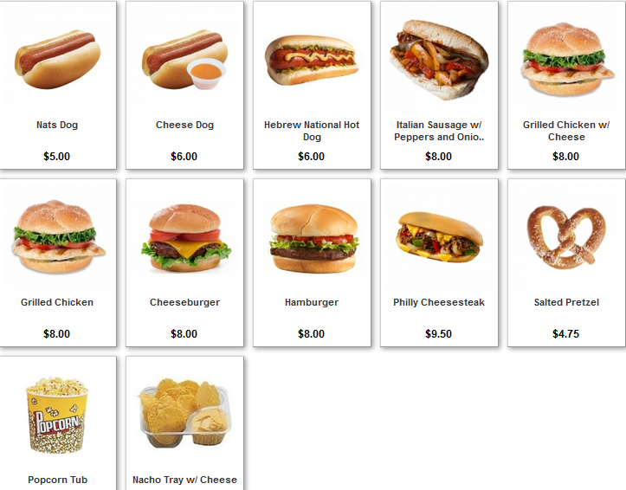
one to many Relationships
The customer may place many orders, but each order can be placed by one customer only.
personID
Name
DOB Gender
Nationality
orderID
personID (foreign key)
Name
Qty
OrderDate

Slide 59

many to one Relationships
The department may have many employees, but each employee can work only in one department.

Slide 60



many to many Relationships
One student may belong to more than one student organizations, and one organization can admit more than one student.

Slide 61
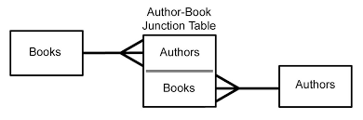
many to many Relationships

Slide 62
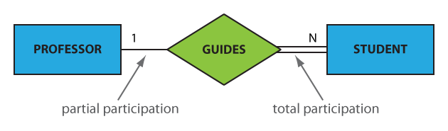
Participation constraints
An entity may participate in a relation either totally or partially.
Total participation means that every entity is involved in the relationship, e.g., each student must be guided by a professor (there are no students who are not guided by any professor. This kind of relation is represented as a double line.
Partial participation means that not all entities are involved in the relationship, e.g., not every professor guides a student (there are professors who don’t). A partial participation is represented by a single line.

Slide 63
What is Data Modeling?

Slide 64
Data Modeling
Data modeling is a process used to define and analyze data requirements needed to support the business processes within the scope of corresponding systems in organizations.
Data modeling involves a progression from conceptual model to logical model to physical object.

Slide 65
What is Schema?

Slide 66
What is Schema?
A schema is a collection of database objects associated with one particular database username. This username is called the schema owner, or the owner of the related group of objects. You may have one or multiple schemas in a database.

Slide 67
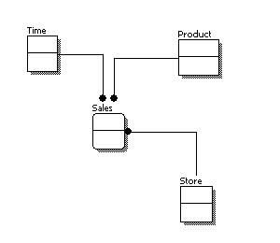
Conceptual Model Design
Features of conceptual data model include:
Includes the important entities and the relationships among them.
No attribute is specified.
No primary key is specified.

Slide 68
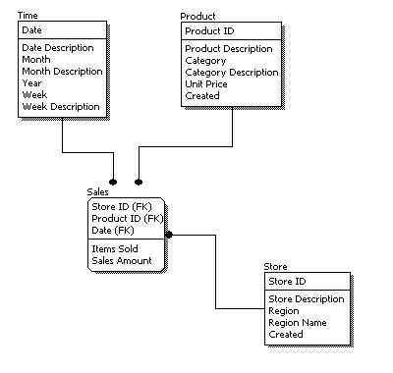
Logical Model Design
Features of logical data model include:
Includes all entities and relationships among them.
All attributes for each entity are specified.
The primary key for each entity is specified.
Foreign keys are specified.

Slide 69
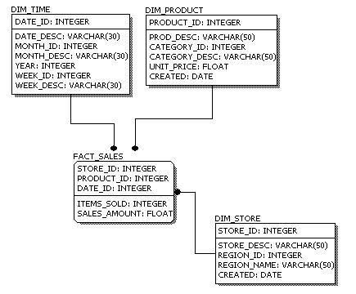
Physical Model Design
Features of physical data model include:
Convert entities into tables.
Convert relationships into foreign keys.
Convert attributes into columns.

Slide 70
Data Modeling
Feature | Conceptual | Logical | Physical
Entity Names | ✓ | ✓
Entity Relationships | ✓ | ✓
Attributes |  | ✓
Primary Keys |  | ✓ | ✓
Foreign Keys |  | ✓ | ✓
Table Names |  |  | ✓
Column Names |  |  | ✓
Column Data Types |  |  | ✓

Slide 71
SQL Structured Query Language

Slide 72
What is SQL?
SQL Structured Query Language is a database language designed and developed for managing data in relational database management systems (RDBMS). SQL is common language for all Relational Databases.

Slide 73
Comments in MySQL
From a # character to the end of the line.
From a -- sequence to the end of the line.
From a /* sequence to the following */ sequence.

Slide 74
Login to MySQL

Slide 75
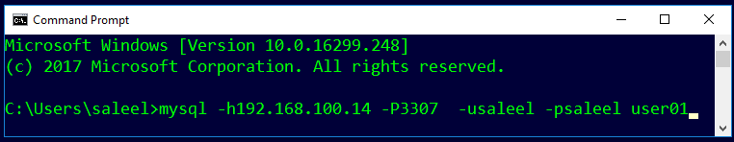
Login
Default port for MySQL Server: 3306
C:\> mysql –hstp5 –P3307 –usaleel –p user01
C:\> mysql –h192.168.100.14 –P3307 –usaleel –p user01
C:\> mysql –h192.168.100.14 –P3307 –usaleel –psaleel user01

Slide 76
STORAGE ENGINES
A storage engine is a software module that a database management system uses to create, read, update data from a database. There are two types of storage engines in MySQL: transactional and non-transactional.

Slide 77
ENGINES
InnoDB is the most widely used storage engine with transaction support. It is the only engine which provides foreign key referential integrity constraint. Oracle recommends using InnoDB for tables except for specialized use cases.
MyISAM is the original storage engine. It is a fast storage engine. It does not support transactions. MyISAM provides table-level locking. It is used mostly in Web and data warehousing.
Memory storage engine creates tables in memory. It is the fastest engine. It provides table-level locking. It does not support transactions. Memory storage engine is ideal for creating temporary tables or quick lookups. The data is lost when the database is restarted.
CSV stores data in CSV files. It provides great flexibility because data in this format is easily integrated into other applications.

Slide 78
SHOW ENGINES Syntax
For MySQL 5.5 and later, the default storage engine is InnoDB. The default storage engine for MySQL prior to version 5.5 was MyISAM.
SHOW [STORAGE] ENGINES
SHOW ENGINES displays status information about the server's storage engines. This is particularly useful for checking whether a storage engine is supported, or to see what the default engine is.
INFORMATION_SCHEMA.ENGINES
show engines;
show STORAGE engines;
INFORMATION_SCHEMA provides access to database metadata, information about the MySQL server such as the name of a database or table, the data type of a column, or access privileges.

Slide 79
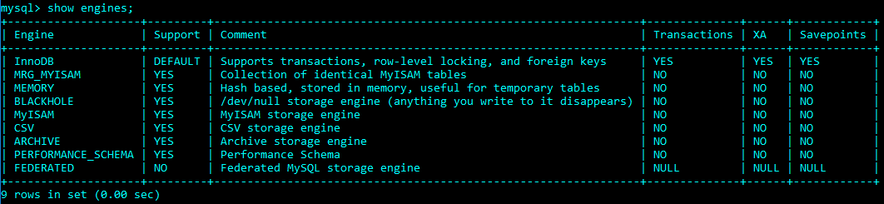
ENGINES
SET DEFAULT_STORAGE_ENGINE = InnoDB;

Slide 80
SHOW DATABASES

Slide 81
SHOW DATABASES Syntax
SHOW {DATABASES | SCHEMAS} [LIKE 'pattern' | WHERE expr]
SHOW SCHEMAS is a synonym for SHOW DATABASES.
SHOW DATABASES;
SHOW SCHEMAS;
SHOW DATABASES LIKE 'U%';
SHOW SCHEMAS LIKE 'U%';

Slide 82
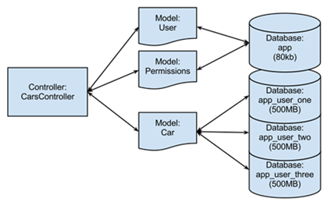
USE DATABASES
The USE db_name statement tells MySQL to use the db_name database as the default (current) database for subsequent statements. The database remains the default until the end of the session or another USE statement is issued.

Slide 83
USE DATABASES Syntax
USE db_name
USE, does not require a semicolon.
USE must be followed by a database name.
USE USER01
\u USER01

Slide 84
CREATE DATABASE

Slide 85
CREATE DATABASE
CREATE DATABASE creates a database with the given name. To use this statement, you need the CREATE privilege for the database.
CREATE {DATABASE | SCHEMA} [IF NOT EXISTS] db_name
CREATE SCHEMA is a synonym for CREATE DATABASE.
CREATE DATABASE USER01;
CREATE DATABASE IF NOT EXISTS USER01;

Slide 86
DROP DATABASE
If the default database is dropped, the default database is unset (the DATABASE() function returns NULL).

Slide 87
DROP DATABASE
DROP DATABASE drops all tables in the database and deletes the database. Be very careful with this statement! To use DROP DATABASE, you need the DROP privilege on the database.
DROP {DATABASE | SCHEMA} [IF EXISTS] db_name
DROP SCHEMA is a synonym for DROP DATABASE.
DROP database USER01;
DROP database IF EXISTS USER01;

Slide 88
Information Functions
Use these function with SELECT statement

Slide 89
Information Functions
FOUND_ROWS() - For a SELECT with a LIMIT clause, the number of rows that would be returned were there no LIMIT clause
LAST_INSERT_ID() - Value of the AUTOINCREMENT column for the last INSERT
ROW_COUNT() - The number of rows updated
DATABASE() - Return the default (current) database name
SCHEMA() - Synonym for DATABASE()
SELECT database();

Slide 90
Information Functions
CURRENT_USER(), CURRENT_USER - The authenticated user name and host name
USER() - The user name and host name provided by the client
SESSION_USER() - Synonym for USER()
SYSTEM_USER() - Synonym for USER()
VERSION() - Return a string that indicates the MySQL server version
CONNECTION_ID() - Return the connection ID (thread ID) for the connection
SELECT user();

Slide 91
Source Command

Slide 92
Source command
You can execute an SQL script file using the source command or \. command
\. file_name
source file_name
\. 'D:\MySQLDEMOBLD7.SQL'
SOURCE 'D:\MySQLDEMOBLD7.SQL‘
SOURCE //infoserver1/infodomain1/Everyone/DBT/MySQLDEMOBLD7.SQL

Slide 93
SHOW COLUMNS

Slide 94
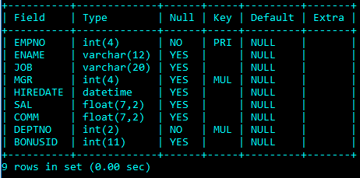
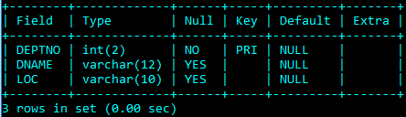
EMP & DEPT Table structure

Slide 95
SHOW COLUMNS Syntax
SHOW [FULL] {COLUMNS | FIELDS} {FROM | IN} tbl_name [{FROM | IN} db_name] [LIKE 'pattern' | WHERE expr]
show columns from EMP;
show columns in EMP;
show full columns from EMP; // with Privileges
show columns from EMP from user01;
show columns from user01.EMP;
show columns from EMP like 'E%'; // starting with E
show columns from EMP where field in ('ename'); // only ename column

Slide 96
SHOW TABLES

Slide 97
SHOW TABLES Syntax
SHOW [FULL] TABLES [{FROM | IN} db_name] [LIKE 'pattern' | WHERE expr]
show tables;
show full tables; // with Table Type
show tables from user01;
show tables where tables_in_user01 like 'e%' or tables_in_user01 like 'B%';
show tables where tables_in_user01 in ('EMP');

Slide 98
SHOW TABLES STATUS

Slide 99
SHOW TABLES STATUS Syntax
SHOW TABLE STATUS [{FROM | IN} db_name] [LIKE 'pattern' | WHERE expr]
show table status;
show table status from user01;
show table status in user01;
show table status like 'EMP';

Slide 100
SHOW VARIABLES
shows the values of MySQL system variables.

Slide 101
SHOW VARIABLES Syntax
SHOW [GLOBAL | SESSION] VARIABLES [LIKE 'pattern' | WHERE expr]

Slide 102
SHOW [GLOBAL | SESSION] VARIABLES [LIKE 'pattern' | WHERE expr]

Slide 103
Explain

Slide 104
Explain
The DESCRIBE and EXPLAIN statements are synonyms. In practice, the DESCRIBE keyword is more often used to obtain information about table structure, whereas EXPLAIN is used to obtain a query execution plan.
{EXPLAIN | DESCRIBE | DESC}
tbl_name [col_name]
DESC EMP;
DESC EMP ENAME;
DESCRIBE EMP;
EXPLAIN EMP;
EXPLAIN EMP empno;
EXPLAIN works with SELECT, DELETE, INSERT, REPLACE, and UPDATE statements.

Slide 105
Explain
The DESCRIBE and EXPLAIN statements are synonyms. In practice, the DESCRIBE keyword is more often used to obtain information about table structure, whereas EXPLAIN is used to obtain a query execution plan.
{EXPLAIN | DESCRIBE | DESC}
{explainable_stmt}
explainable_stmt: {
SELECT statement
| DELETE statement
| INSERT statement
| REPLACE statement
| UPDATE statement
}
EXPLAIN SELECT * FROM EMP;
EXPLAIN SELECT * FROM EMP where empno=7788;
EXPLAIN SELECT * FROM EMP INNER JOIN DEPT USING(DEPTNO);

Slide 106
SELECT statement…

Slide 107
SELECT CLAUSE
The SELECT statement retrieves or extracts data from tables in the database.
You can use one or more tables separated by comma to include various conditions using a WHERE clause, but WHERE clause is an optional part of SELECT command.
You can fetch one or more fields in a single SELECT command.
You can specify star (*) in place of fields. In this case, SELECT will return all the fields.
You can specify any condition using WHERE clause.
You can specify an offset using OFFSET from where SELECT will start returning records. By default offset is zero.
You can limit the number of returns using LIMIT attribute.

Slide 108
Capabilities of SELECT Statement
SELECTION
PROJECTION
JOINING

Slide 109
Capabilities of SELECT Statement
SELECTION
Selection capability in SQL is to choose the rows in a table that you want to return by a query.
EMPNO | ENAME | JOB | HIREDATE
1 | Saleel | Manager | 01-Jan-95
2 | Janhavi | Sales | 20-Dec-94
3 | Snehal | Manager | 21-May-97
4 | Rahul | Account | 30-Jul-97
5 | Ketan | Sales | 01-Jan-94

Slide 110
Capabilities of SELECT Statement
PROJECTION
Projection capability in SQL to choose the columns in a table that you want to return by your query.
EMPNO | ENAME | JOB | HIREDATE
1 | Saleel | Manager | 01-Jan-95
2 | Janhavi | Sales | 20-Dec-94
3 | Snehal | Manager | 21-May-97
4 | Rahul | Account | 30-Jul-97
5 | Ketan | Sales | 01-Jan-94

Slide 111
Capabilities of SELECT Statement
JOINING
Join capability in SQL to bring together data that is stored in different tables by creating a link between them.
EMPNO | ENAME | JOB | HIREDATE | DEPTNO
1 | Saleel | Manager | 01-Jan-95 | 20
2 | Janhavi | Sales | 20-Dec-94 | 10
3 | Snehal | Manager | 21-May-97 | 10
4 | Rahul | Account | 30-Jul-97 | 20
5 | Ketan | Sales | 01-Jan-94 | 30
DEPTNO | DNAME | LOC
10 | HRD | PUNE
20 | SALES | BARODA

Slide 112
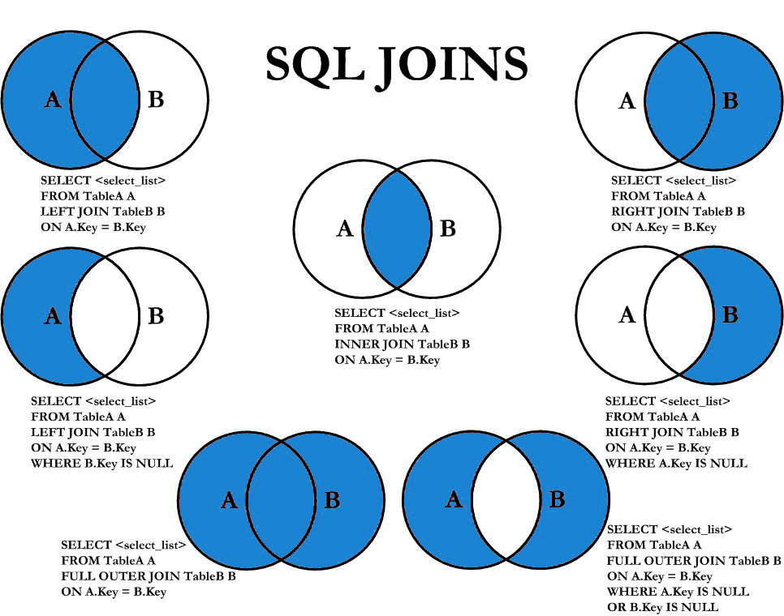

Slide 113
SELECT statement
SELECTION Process
SELECT * FROM <table_references>
Selection-List
PROJECTION Process
SELECT column-list FROM <table_references>
Selection-List

Slide 114
In the select list of a query, a quoted column alias can be specified using identifier ( ` ) or string quoting ( ' or " ) characters.
Column - ALIAS
SELECT 'HELLO' ' WORLD';
SELECT 'HELLO' AS ' WORLD';
SELECT ENAME `EmployeeName` FROM EMP;
SELECT ENAME AS `EmployeeName` FROM EMP;

Slide 115
SELECT statement - ALIAS
A programmer can use an alias to temporarily assign another name to a table or column for the duration of a SELECT query. Assigning an alias does not actually rename the column or table.
A select_expr can be given an alias using AS alias_name. The alias is used as the expression's column name and can be used in GROUP BY, ORDER BY, or HAVING clauses.
The AS keyword is optional when aliasing a select_expr with an identifier.
Standard SQL disallows references to column aliases in a WHERE clause.
A table reference can be aliased using tbl_name AS alias_name or tbl_name alias_name
If the column alias contains spaces, put it in quotes.

Slide 116
SELECT statement - ALIAS
SQL aliases are used to give a table, or a column in a table, a temporary name.
Column ALIAS
SELECT ColName1 [ [as] alias_name], ColName2 [ [as] alias_name],... ColN from <table_references> [ [as] alias_name]
SELECT EMPNO as EmployeeNumber, ENAME EmployeeName FROM EMP;
SELECT ENAME "Employee Name" FROM EMP;
SELECT ENAME 'Employee Name' FROM EMP;
SELECT * FROM EMP E;
You can use the alias in GROUP BY, ORDER BY, or HAVING clauses to refer to the column.
Standard SQL disallows references to column aliases in a WHERE clause.

Slide 117
SELECT statement - ALIAS
SQL aliases are used to give a table, or a column in a table, a temporary name.
Column ALIAS
You can use the alias in GROUP BY, ORDER BY, or HAVING clauses to refer to the column.
SELECT orderNumber `Order no.`, SUM(price * quantity) total
FROM orderdetails
GROUP BY `Order no.`
HAVING total > 60000;

Slide 118
Column - EXPRESSIONS

Slide 119
SELECT statement - EXPRESSIONS
Column EXPRESSIONS
SELECT ColName1, expressions,... from <table_references>
SELECT 1001 + 1;
SELECT 1001 + 1 FROM DUAL;
SELECT '1' + '1' ;
SELECT '1' + 'a1';
SELECT '1' + '1a';
SELECT 'a1' + 1;
SELECT '1a' + 1;
SELECT SAL, SAL + 1000 AS 'New Salary' FROM EMP;
SELECT SAL, COMM, SAL + COMM FROM EMP;
SELECT SAL, COMM, SAL + IFNULL (COMM, 0) FROM EMP;

Slide 120
Comparison Functions and Operator

Slide 121
Comparison Functions and Operator
BETWEEN ... AND ... | Check whether a value is within a range of values
COALESCE() | Return the first non-NULL argument
= | Equal operator
<=> | NULL-safe equal to operator
> | Greater than operator
>= | Greater than or equal operator
IN() | Check whether a value is within a set of values
IS | Test a value against a boolean
IS NOT | Test a value against a boolean
IS NOT NULL | NOT NULL value test
IS NULL | NULL value test
ISNULL() | Test whether the argument is NULL
< | Less than operator
<= | Less than or equal operator
LIKE | Simple pattern matching
NOT BETWEEN ... AND ... | Check whether a value is not within a range of values
!=, <> | Not equal operator
NOT IN() | Check whether a value is not within a set of values
NOT LIKE | Negation of simple pattern matching

Slide 122
BETWEEN ... AND ...
Check whether a value is within a range of values
All three expressions: expr, begin_expr, and end_expr must have the same data type.
Comparison BETWEEN ... AND ...
If any expression is NULL, the BETWEEN operator returns a NULL value.

Slide 123
IS
Tests a value against a boolean value, where boolean_value can be TRUE, FALSE, or UNKNOWN.
Comparison IS

Slide 124
Identifier Qualifiers
The maximum length for each type of identifier like (Database, Table, Column, Index, Constraint, View, Stored Program, User-Defined Variable, Tablespace) is 64 characters, whereas for Alias is 256 characters.

Slide 125
Identifier Qualifiers
You can refer to a table within the default database as tbl_name, or as db_name.tbl_name to specify a database explicitly.
You can refer to a column as col_name, tbl_name.col_name, or db_name.tbl_name.col_name.
You need not specify a tbl_name or db_name.tbl_name prefix for a column reference unless the reference would be ambiguous.
The identifier quote character is the backtick (`)

Slide 126
Identifier Qualifiers
In MySQL, you can refer to a table column using any of the following forms.
Column Reference | Description
col_name | The column col_name from whichever table used in the statement contains a column of that name.
tbl_name.col_name | The column col_name from table tbl_name of the default database.
db_name.tbl_name.col_name | The column col_name from table tbl_name of the database db_name.
The identifier quote character is the backtick (`)

Slide 127
Identifier Qualifiers
In MySQL, you can refer to a table using any of the following forms.
Table Reference | Description
tbl_name | The table tbl_name from whichever table used in the statement to fetch the data.
db_name.tbl_name | The table tbl_name from whichever database db_name.
The identifier quote character is the backtick (`)

Slide 128
The NULL value

Slide 129
The NULL value - NULL
The NULL value is special. It means "NO VALUE" or "UNKNOWN VALUE" and cannot be compared to known values the way you compere two known values to each other. If you attempt to use NULL with the usual arithmetic comparison operators, the result is undefined (NULL).
Instead of using =, < >, or != to test for equality or inequality with NULL values, use IS NULL or IS NOT NULL
MySQL specific <=> comparison operator is true even for NULL-to-NULL comparisons.

Slide 130
Control Flow Functions

Slide 131
Control Flow Functions - IFNULL
IFNULL function
MySQL IFNULL() takes two expressions, if the first expression is not NULL, it returns the first expression. Otherwise, it returns the second expression, it returns either numeric or string value.
IFNULL(expression1, expression2)
SELECT IFNULL (1, 2) as R1;
SELECT IFNULL (null, 2) as R1;
SELECT IFNULL (1/0, 2) as R1;
SELECT IFNULL (1/0, 'Yes') as R1;
SELECT comm, IFNULL(COMM + COMM*.25, 1000) FROM EMP;

Slide 132
Control Flow Functions - IF
IF function
If expr1 is TRUE or expr1 <> 0 or expr1 <> NULL, then IF() returns expr2, otherwise it returns expr3, it returns either numeric or string value.
IF(expr1, expr2 , expr3)
SELECT IF(1 > 2, 2, 3) as R1;
SELECT sal, IF(sal = 3000, 'Ok', 'Not Bad') R1 FROM EMP;
SELECT ename, sal, IF(sal = 3000 and ename = 'FORD', 'Y', 'N') R1 FROM EMP;
SELECT ename, sal, comm, IF(comm is NULL && ename = 'FORD', 'Y', 'N') R1 FROM EMP;
SELECT deptno, IF(deptno = 10, 'Sales', IF(deptno = 20 , 'Purchase' ,'N/A')) R1 FROM EMP;

Slide 133
Control Flow Functions - NULLIF
NULLIF function
Returns NULL if expr1 = expr2 is true, otherwise returns expr1.
NULLIF(expr1, expr2)
SELECT NULLIF(1, 1) as R1;
SELECT NULLIF(1, 2) as R1;

Slide 134
Control Flow Functions - CASE
CASE function
Returns the result for the first condition that is true. If there was no matching result value, the result after ELSE is returned, or NULL if there is no ELSE part.
CASE value WHEN [compare_value] THEN result [WHEN [compare_value] THEN result ...] [ELSE result] END
SELECT deptno, CASE deptno when 10 then 'Accounts' when 20 then 'Sales' ELSE 'N/A' END R1 FROM EMP;
SELECT deptno, CASE deptno when 10 then 'Accounts' ELSE 'N/A' END CASE FROM EMP; // error

Slide 135
Control Flow Functions - CASE
CASE function
Returns the result for the first condition that is true. If there was no matching result value, the result after ELSE is returned, or NULL if there is no ELSE part.
CASE WHEN [condition] THEN result [WHEN [condition] THEN result ...] [ELSE result] END
SELECT deptno, CASE when deptno = 10 then 'Sales' when deptno = 20 then 'Purchase' ELSE 'N/A' END R1 FROM EMP;

Slide 136
Date and Time Functions

Slide 137
NOW(), CURDATE(), CURTIME()
DateTime Functions
In MySQL, the NOW() function returns a default value for a DATETIME.
MySQL inserts the current date and time into the column whose default value is NOW().
In MySQL, the CURDATE() returns the current date in 'YYYY-MM-DD'. CURRENT_DATE() and CURRENT_DATE are the synonym of CURDATE().
In MySQL, the CURTIME() returns the value of current time in 'HH:MM:SS'. CURRENT_TIME() and CURRENT_TIME are the synonym of CURTIME().

Slide 138
NOW(), CURDATE(), CURTIME()
DateTime Functions
SELECT NOW()
SELECT CURDATE()
SELECT CURTIME()
Result in something like this:
NOW() CURDATE() CURTIME()
2017-02-11 10:22:31 2017-02-11 10:22:31

Slide 139
Date()
DateTime Functions
The DATE() function extracts the date value from a date or datetime expression.
DATE(expr)
SELECT DATE("2017-06-15 09:34:21")
SELECT NOW(), DATE (NOW())
Returns NULL if expression is not a date or a datetime value.

Slide 140
+ or - operator
DateTime Functions
Date arithmetic also can be performed using INTERVAL together with the + or - operator
date + INTERVAL expr unit / date - INTERVAL expr unit
SELECT NOW(), NOW() + INTERVAL 1 DAY;
unit Value | ExpectedexprFormat
SECOND | SECONDS
MINUTE | MINUTES
HOUR | HOURS
DAY | DAYS
WEEK | WEEKS
MONTH | MONTHS
QUARTER | QUARTERS
YEAR | YEARS

Slide 141
ADDDATE()
DateTime Functions
ADDDATE() is a synonym for DATE_ADD().
ADDDATE(date, INTERVAL expr unit) / ADDDATE(expr, days)
SELECT NOW(), ADDDATE(NOW(), interval 1 DAY)
unit Value | ExpectedexprFormat
SECOND | SECONDS
MINUTE | MINUTES
HOUR | HOURS
DAY | DAYS
WEEK | WEEKS
MONTH | MONTHS
QUARTER | QUARTERS
YEAR | YEARS

Slide 142
DATE_ADD()
DateTime Functions
DATE_ADD(date, INTERVAL expr unit)
SELECT NOW(), DATE_ADD(NOW(), interval 1 DAY)
unit Value | ExpectedexprFormat
SECOND | SECONDS
MINUTE | MINUTES
HOUR | HOURS
DAY | DAYS
WEEK | WEEKS
MONTH | MONTHS
QUARTER | QUARTERS
YEAR | YEARS

Slide 143
DATE_SUB()
DateTime Functions
DATE_SUB() is a synonym for SUBDATE().
DATE_SUB(date, INTERVAL expr unit)
SELECT NOW(), DATE_SUB(NOW(), interval 1 DAY);
unit Value | ExpectedexprFormat
SECOND | SECONDS
MINUTE | MINUTES
HOUR | HOURS
DAY | DAYS
WEEK | WEEKS
MONTH | MONTHS
QUARTER | QUARTERS
YEAR | YEARS

Slide 144
ADDTIME()
DateTime Functions
ADDTIME() adds expr2 to expr1 and returns the result. expr1 is a time or datetime expression, and expr2 is a time expression.
ADDTIME(expr1, expr2)
SELECT NOW(), ADDTIME(NOW(), '1:1:1') // 'HH:MM:SS'
SELECT NOW(), ADDTIME(NOW(), '2 2:10:5') // 'DAY HH:MM:SS'

Slide 145
SUBTIME()
DateTime Functions
SUBTIME() returns expr1 − expr2 expressed as a value in the same format as expr1. expr1 is a time or datetime expression, and expr2 is a time expression.
SUBTIME(expr1, expr2)
SELECT NOW(), SUBTIME(NOW(), '1:1:1') // 'HH:MM:SS'
SELECT NOW(), SUBTIME(NOW(), '2 1:1:1') // 'DAY HH:MM:SS'

Slide 146
EXTRACT
DateTime Functions
The EXTRACT() function is used to return a single part of a date/time, such as year, month, day, hour, minute, etc.
EXTRACT(unit FROM date)
Unit Value
MICROSECOND | SECOND | MINUTE | HOUR | DAY
WEEK | MONTH | QUARTER | YEAR
MINUTE_SECOND | HOUR_SECOND | DAY_SECOND | DAY_HOUR
HOUR_MINUTE | DAY_MINUTE | YEAR_MONTH
SELECT EXTRACT (DAY_MINUTE FROM NOW())
SELECT EXTRACT (YEAR_MONTH FROM NOW())

Slide 147
PERIOD_DIFF()
DateTime Functions
MySQL PERIOD_DIFF() returns the difference between two periods. Periods should be in the same format i.e. YYYYMM or YYMM.
PERIOD_DIFF(P1, P2);
SELECT PERIOD_DIFF(201701, 201601);
SELECT PERIOD_DIFF (EXTRACT (YEAR_MONTH FROM now()), EXTRACT (YEAR_MONTH FROM hiredate)) AS R1 FROM EMP;

Slide 148
from Kedar Ghadge
TIMESTAMPADD()
DateTime Functions
TODO
TIMESTAMPADD (<unit>, interval, date_time);
date_time + interval
Unit Value
YEAR | DAY | HOUR | MINUTE
SECOND | WEEK | MONTH
SELECT timestampadd (month, 2, '2017-03-26')

Slide 149
from Kedar Ghadge
TIMESTAMPDIFF()
DateTime Functions
TODO
TIMESTAMPDIFF (<unit>, date1, date2)
Date2 – Date1
Unit Value
YEAR | DAY | HOUR | MINUTE
SECOND | WEEK | MONTH
SELECT Timestampdiff (month, hiredate, now()) FROM EMP;

Slide 150
Date Functions
DateTime Functions
Syntax | Result
DAY(date) | DAY() is a synonym for DAYOFMONTH().
DAYNAME(date) | Returns the name of the weekday for date.
DAYOFMONTH(date) | Returns the day of the month for date, in the range 1 to 31
DAYOFWEEK(date) | Returns the weekday index for date (1 = Sunday, 2 = Monday, …, 7 = Saturday).
DAYOFYEAR(date) | Returns the day of the year for date, in the range 1 to 366
LAST_DAY(date) | Takes a date or datetime value and returns the corresponding value for the last day of the month. Returns NULL if the argument is invalid.
MONTH(date) | Returns the month for date, in the range 1 to 12 for January to December
MONTHNAME(date) | Returns the full name of the month for date.
SELECT dayofweek (now()), WEEKDAY(now());
SELECT dayofweek (date_add(now(), interval 1 day)), weekday (date_add (now(), interval 1 day));

Slide 151
Date Functions
DateTime Functions
Syntax | Result
WEEKDAY(date) | Returns the weekday index for date (0 = Monday, 1 = Tuesday, … 6 = Sunday).
WEEKOFYEAR(date) | Returns the calendar week of the date as a number in the range from 1 to 53.
QUARTER(date) | Returns the quarter of the year for date, in the range 1 to 4.
HOUR(time) | Returns the hour for time. The range of the return value is 0 to 23 for time-of-day values.
MINUTE(time) | Returns the minute for time, in the range 0 to 59.
SECOND(time) | Returns the second for time, in the range 0 to 59.
DATEDIFF(expr1,expr2) | Returns the number of days between two dates or datetimes.
SELECT NOW(), NOW() + interval 1 DAY, WEEKDAY(NOW() + interval 1 DAY);
SELECT * FROM EMP WHERE DAY(HIREDATE) = 17;

Slide 152
Date and Time Formats

Slide 153
DateTime Formats
Formats | Description
%a | Abbreviated weekday name (Sun-Sat)
%b | Abbreviated month name (Jan-Dec)
%c | Month, numeric (0-12)
%D | Day of month with English suffix (0th, 1st, 2nd, 3rd, �)
%d | Day of month, numeric (00-31)
%e | Day of month, numeric (0-31)
%f | Microseconds (000000-999999)
%H | Hour (00-23)
%h | Hour (01-12)
SELECT DATE_FORMAT (now(), '%a');

Slide 154
DateTime Formats
Formats | Description
%I | Hour (01-12)
%i | Minutes, numeric (00-59)
%j | Day of year (001-366)
%k | Hour (0-23)
%l | Hour (1-12)
%M | Month name (January-December)
%m | Month, numeric (00-12)
%p | AM or PM
%r | Time, 12-hour (hh:mm:ss followed by AM or PM)
%S | Seconds (00-59)
%s | Seconds (00-59)

Slide 155
DateTime Formats
Formats | Description
%T | Time, 24-hour (hh:mm:ss)
%U | Week (00-53) where Sunday is the first day of week
%u | Week (00-53) where Monday is the first day of week
%V | Week (01-53) where Sunday is the first day of week, used with %X
%v | Week (01-53) where Monday is the first day of week, used with %x
%W | Weekday name (Sunday-Saturday)
%w | Day of the week (0=Sunday, 6=Saturday)
%X | Year for the week where Sunday is the first day of week, four digits, used with %V
%x | Year for the week where Monday is the first day of week, four digits, used with %v
%Y | Year, numeric, four digits
%y | Year, numeric, two digits

Slide 156
String Functions

Slide 157
String Functions
Syntax | Result
ASCII(str) | Returns the numeric value of the leftmost character of the string str. Returns 0 if str is the empty string. Returns NULL if str is NULL. e.g. SELECT ascii(ename) from EMP;
CHAR(N,...) | CHAR() interprets each argument N as an integer and returns a string consisting of the characters given by the code values of those integers. NULL values are skipped. e.g. SELECT char(65, 66, 67);
CONCAT(str1,str2,...) | Returns the string that results from concatenating the arguments. CONCAT() returns NULL if any argument is NULL. e.g. SELECT concat('Mr. ' , ename) from EMP;

Slide 158
String Functions
Syntax | Result
CONCAT(str1,str2,...) | For quoted strings, concatenation can be performed by placing the strings next to each other. e.g. SELECT 'My' 'S' 'QL';
ELT(N,str1,str2,str3,...) | ELT() returns the Nth element of the list of strings: str1 if N = 1, str2 if N = 2, and so on. Returns NULL if N is less than 1 or greater than the number of arguments. e.g. SELECT ELT(1, 'Infoway', 'Technologies', 'Kothrud', 'Pune'); SELECT ELT(1, ename, job, sal) from EMP;
STRCMP(expr1,expr2) | STRCMP() returns 0 if the strings are the same, -1 if the first argument is smaller than the second according to the current sort order, and 1 otherwise.

Slide 159
String Functions
Syntax | Result
FIELD(str,str1,str2,str3,...) | Returns the index (position) of str in the str1, str2, str3, ... list. Returns 0 if str is not found. If str is NULL, the return value is 0. e.g. SELECT field('pune', 'Infoway', 'Technologies', 'Kothrud', 'Pune'); SELECT field(NULL, 'Infoway', 'Technologies', 'Kothrud', 'Pune'); SELECT field('', 'Infoway', 'Technologies', 'Kothrud', 'Pune');
LCASE(str) | Returns lower case string. LCASE() is a synonym for LOWER().
UCASE(str) | Returns upper case string. UCASE() is a synonym for UPPER()..
LENGTH(str) | Returns the length of the string.
LPAD(str, len, padstr) | Returns the string str, left-padded with the string padstr to a length of len characters.

Slide 160
String Functions
Syntax | Result
RPAD(str, len, padstr) | Returns the string str, right-padded with the string padstr to a length of len characters.
LEFT(str, len) | Returns the leftmost len characters from the string str, or NULL if any argument is NULL.
RIGHT(str, len) | Returns the rightmost len characters from the string str, or NULL if any argument is NULL.
LTRIM(str) | Returns the string str with leading space characters removed.
RTRIM(str) | Returns the string str with trailing space characters removed.
TRIM([{BOTH | LEADING | TRAILING} [remstr] FROM] str) | SELECT TRIM(LEADING 'x' FROM 'xxxABCxxx'); -> 'ABCxxx' SELECT TRIM(BOTH 'x' FROM 'xxxABCxxx'); -> 'ABC' SELECT TRIM(TRAILING 'xyz' FROM 'ABCxxyz'); -> 'ABCx'
If none of the specifiers BOTH, LEADING, or TRAILING is given, BOTH is assumed. remstr is optional and, if not specified, spaces are removed.

Slide 161
String Functions
Syntax | Result
FORMAT(X,D) | Formats the number X to a format like '#,###,###.##', rounded to D decimal places, and returns the result as a string. If D is 0, the result has no decimal point or fractional part. e.g. SELECT format(1234.456,2);
INSTR(str, substr) | Returns the position of the first occurrence of substring substr in string str.
REPLACE(str, from_str, to_str) | Returns the string str with all occurrences of the string from_str replaced by the string to_str. REPLACE() performs a case-sensitive match when searching for from_str. e.g. SELECT replace('Hello', 'l', 'x');
REVERSE(str) | Returns the string str with the order of the characters reversed.
SUBSTR(str, pos, len) | SUBSTR() is a synonym for SUBSTRING(). e.g. SELECT substr ('This is the test by IWAY', 6); SELECT substr ('This is the test by IWAY', -4, 4);
MID(str, pos, len) | MID(str, pos, len) is a synonym for SUBSTRING(str, pos, len).

Slide 162
Mathematical Functions

Slide 163
Mathematical Functions
Syntax | Result
ABS(X) | Returns the absolute value of X.
CEIL(X) | CEIL() is a synonym for CEILING().
CEILING(X) | Returns CEIL value.
FLOOR(X) | Returns FLOOR value.
MOD(N,M), N % M, N MOD M | Returns the remainder of N divided by M. MOD(N,0) returns NULL.
POWER(X,Y) | This is a synonym for POW().

Slide 164
Mathematical Functions
Syntax | Result
RAND([N]) | Returns a random floating-point value v
ROUND(X) ROUND(X,D) | Rounds the argument X to D decimal places. The rounding algorithm depends on the data type of X. D defaults to 0 if not specified. D can be negative to cause D digits left of the decimal point of the value X to become zero.
TRUNCATE(X,D) | Returns the number X, truncated to D decimal places. If D is 0, the result has no decimal point or fractional part. D can be negative to cause D digits left of the decimal point of the value X to become zero.
SELECT ROUND(RAND() * 100)

Slide 165

SELECT statement… syntax
SELECT is used to retrieve rows selected from one or more tables, and can include UNION statements and subqueries.

Slide 166
SELECT statement
SELECT syntax
DISTINCTROW is a synonym for DISTINCT.
SELECT [ALL / DISTINCT / DISTINCTROW] * / ColName1, ColName2, expressions,... from <table_references>
[WHERE where_condition]
[GROUP BY {col_name | expr | position} [ASC | DESC], ... [WITH ROLLUP]]
[HAVING where_condition]
[ORDER BY {col_name | expr | position} [ASC | DESC], ...]
[LIMIT {[offset,] row_count | row_count OFFSET offset}]
The ALL and DISTINCT modifiers specify whether duplicate rows should be returned. ALL (the default) specifies that all matching rows should be returned, including duplicates. DISTINCT specifies removal of duplicate rows from the result set. It is an error to specify both modifiers. DISTINCTROW is a synonym for DISTINCT.

Slide 167
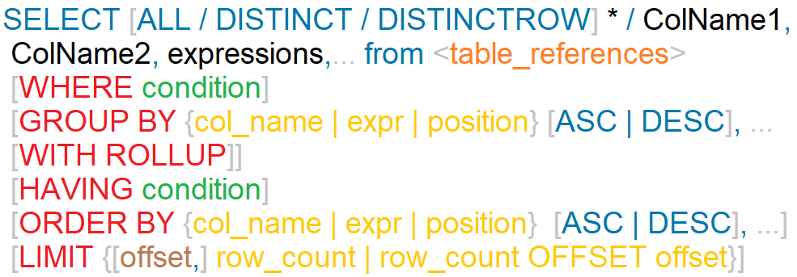
SELECT statement
SELECT syntax
DISTINCTROW is a synonym for DISTINCT.
The ALL and DISTINCT modifiers specify whether duplicate rows should be returned. ALL (the default) specifies that all matching rows should be returned, including duplicates. DISTINCT specifies removal of duplicate rows from the result set. It is an error to specify both modifiers. DISTINCTROW is a synonym for DISTINCT.

Slide 168
Nulls by default occur at the top, but you can use IsNull to assign default values, that will put it in the position you require.
The ISNULL() function tests whether an expression is NULL. If expression is a NULL value, the ISNULL() function returns 1. Otherwise, it returns 0.
ORDER BY Clause
To sort a result, use an ORDER BY clause.
You can sort on multiple columns, and you can sort different columns in different directions.
The default sort order is ascending, with smallest values first. To sort in reverse (descending) order, add the DESC keyword to the name of the column you are sorting by.
SELECT id AS 'a' FROM tbl_name ORDER BY `a`;
SELECT id AS 'a' FROM tbl_name ORDER BY 'a';

Slide 169
SELECT - ORDER BY
The ORDER BY clause is used to sort the records in your result set.
SELECT column-list from <table_references>
[ORDER BY {col_name | expr | position} [ASC | DESC], ...]
If the ASC or DESC modifier is not provided in the ORDER BY clause, the results will be sorted by expression in ascending order. This is equivalent to ORDER BY expression ASC.
The ORDER BY clause can be used in a SELECT statement, SELECT LIMIT statement, Update LIMIT, and DELETE LIMIT statement in MySQL.

Slide 170
SELECT - ORDER BY
The ORDER BY clause is used to sort the records in your result set.
SELECT column-list from <table_references>
[ORDER BY {col_name | expr | position} [ASC | DESC], ...]
SELECT * FROM EMP ORDER BY COMM
SELECT * FROM EMP ORDER BY COMM is null
SELECT ENAME, length(ENAME) FROM EMP ORDER BY length(ENAME), ENAME desc
SELECT * FROM EMP ORDER BY IF(JOB = ‘manager', 3, IF(JOB = 'salesman', 2, null))
SELECT * FROM EMP ORDER BY FIELD(JOB, 'manager', 'salesman')
SELECT * FROM EMP ORDER BY ISNULL(COMM), COMM
SELECT ENAME `e` FROM EMP ORDER BY `e`
SELECT ENAME `e` FROM EMP ORDER BY e
SELECT ENAME 'e' FROM EMP ORDER BY 'e'

Slide 171
In WHERE clause operations can be performed using…
CONSTANTS
TABLE columns
FUNCTION calls (PRE-DEFINED / UDF)
WHERE Clause
The WHERE Clause is used when you want to retrieve specific information from a table excluding other irrelevant data.
Expressions in WHERE clause can use
Arithmetic operators
Comparison operators
Logical operators

Slide 172
SELECT - WHERE
We can use a conditional clause called WHERE clause to filter out results. Using WHERE clause, we can specify a selection criteria to select required records from a table.
SELECT column-list from <table_references>
[WHERE where_condition]
Comparison Functions and Operators
= | Equal operator
> | Greater than operator
>= | Greater than or equal operator
< | Less than operator
<= | Less than or equal operator
!=, <> | Not equal operator
<=> | NULL-safe equal to operator

Slide 173
SELECT - WHERE
We can use a conditional clause called WHERE clause to filter out results. Using WHERE clause, we can specify a selection criteria to select required records from a table.
SELECT column-list from <table_references>
[WHERE where_condition]
Logical Operators
AND, && | Logical AND eg. SELECT 1 AND 1;
OR, || | Logical OR eg. SELECT 1 OR 1;
NOT, ! | Negates value eg. SELECT 1 NOT 1;
Logical AND. Evaluates to 1 if all operands are nonzero and not NULL, to 0 if one or more operands are 0, otherwise NULL is returned.
Logical OR. When both operands are non-NULL, the result is 1 if any operand is nonzero, and 0 otherwise. With a NULL operand, the result is 1 if the other operand is nonzero, and NULL otherwise. If both operands are NULL, the result is NULL.
Logical NOT. Evaluates to 1 if the operand is 0, to 0 if the operand is nonzero, and NOT NULL returns NULL.

Slide 174
SELECT - WHERE
We can use a conditional clause called WHERE clause to filter out results. Using WHERE clause, we can specify a selection criteria to select required records from a table.
SELECT column-list from <table_references>
[WHERE where_condition]
Comparison Functions and Operators
IS NULL | NULL value test
IS NOT NULL | NOT NULL value test
ISNULL(expr) | If expr is NULL, ISNULL() returns 1, otherwise it returns 0.
STRCMP(expr1,expr2) | STRCMP() returns 0 if the strings are the same, -1 if the first argument is smaller than the second according to the current sort order, and 1 otherwise.
LEAST(value1,value2,...) | With two or more arguments, returns the smallest argument.
GREATEST(value1,value2,...) | With two or more arguments, returns the largest argument.

Slide 175
SELECT - WHERE
We can use a conditional clause called WHERE clause to filter out results. Using WHERE clause, we can specify a selection criteria to select required records from a table.
SELECT column-list from <table_references>
[WHERE where_condition]
Comparison Functions and Operators
BETWEEN ... AND ... | Check whether a value is within a range of values
NOT BETWEEN ... AND ... | Check whether a value is not within a range of values
expr IN (value,...) | Check whether a value is within a set of values
expr NOT IN (value,...) | Check whether a value is not within a set of values
expr LIKE pat [ESCAPE 'escape_char'] | Pattern matching using an SQL pattern. Returns 1 (TRUE) or 0 (FALSE). If either expr or pat is NULL, the result is NULL.
expr NOT LIKE pat [ESCAPE 'escape_char'] | Negation of simple pattern matching.

Slide 176
SELECT - WHERE
We can use a conditional clause called WHERE clause to filter out results. Using WHERE clause, we can specify a selection criteria to select required records from a table.
SELECT column-list from <table_references>
[WHERE where_condition]
Group Operators
(expr, [expr]…)
ROW(expr, [expr]…)
Note: Both the statements are same.
SELECT * FROM EMP WHERE (DEPTNO, PWD) = (SELECT DEPTNO, PWD FROM DEPT WHERE DEPTNO = 30);
SELECT * FROM EMP WHERE ROW (DEPTNO, PWD) = (SELECT DEPTNO, PWD FROM DEPT WHERE DEPTNO = 30);

Slide 177
SELECT - WHERE
We can use a conditional clause called WHERE clause to filter out results. Using WHERE clause, we can specify a selection criteria to select required records from a table.
SELECT column-list from <table_references>
[WHERE where_condition]
Comparison Functions and Operators
COALESCE(value,...) | Returns the first non-NULL value in the list, or NULL if there are no non-NULL values.
INTERVAL(N,N1,N2,N3,...) | Returns 0 if N < N1, 1 if N < N2 and so on or -1 if N is NULL. All arguments are treated as integers. It is required that N1 < N2 < N3 < ... < Nn for this function to work correctly.
SELECT * FROM EMP WHERE JOB = 'MANAGER' UNION SELECT * FROM EMP WHERE JOB = 'SALESMAN'

Slide 178
IS NULL / IS NOT NULL
"IS NULL" is the keyword that performs the Boolean comparison. It returns true if the supplied value is NULL and false if the supplied value is not NULL.
“IS NOT NULL" is the keyword that performs the Boolean comparison. It returns true if the supplied value is not NULL and false if the supplied value is null.

Slide 179




NULL- IS NULL / IS NOT NULL

Slide 180
Like

Slide 181


Like - String Comparison Functions
syntax
expr LIKE pat [ESCAPE 'escape_char']
% matches any number of characters, even zero characters.
_ matches exactly one character.
If we use default escape character '\', then don’t use ESCAPE keyword.
To test for literal instances of a wildcard character, precede it by the escape character. If you do not specify the ESCAPE character, \ is assumed.
\% matches one % character.
\_ matches one _ character.
The ESCAPE keyword is used to escape pattern matching characters such as the (%) percentage and underscore (_) if they form part of the data.

Slide 182
SELECT … expressions

Slide 183
SELECT - expressions
SELECT syntax
SELECT expressions,... from <table_references>
SELECT ename, ename = ename from EMP;
SELECT ename, ename = 'smith' from EMP;

Slide 184

Standard SQL does not allow you to use an alias in the GROUP BY clause, however, MySQL supports this.
MySQL also allows you to sort the groups in ascending or descending orders while the standard SQL does not.
DISTINCT (if used outside an aggregation function) that is superfluous.
GROUP BY Clause
SELECT id AS 'a', COUNT(*) AS cnt FROM tbl_name GROUP BY `a`;
SELECT id AS 'a', COUNT(*) AS cnt FROM tbl_name GROUP BY 'a';

Slide 185
Standard SQL does not allow you to use an alias in the GROUP BY clause, however, MySQL supports this.
MySQL also allows you to sort the groups in ascending or descending orders while the standard SQL does not.
GROUP BY Clause with DISTINCT
DISTINCT (if used outside an aggregation function) that is superfluous.

Slide 186
SELECT - GROUP BY
Columns selected for output can be referred to in ORDER BY and GROUP BY clauses using column names, column aliases, or column positions. Column positions are integers and begin with 1
If you use GROUP BY, output rows are sorted according to the GROUP BY columns as if you had an ORDER BY for the same columns. To avoid the overhead of sorting that GROUP BY produces, add ORDER BY NULL.
MySQL extends the GROUP BY clause so that you can also specify ASC and DESC after columns named in the clause
If a query includes GROUP BY but you want to avoid the overhead of sorting the result, you can suppress sorting by specifying ORDER BY NULL.
For example:
SELECT JOB, COUNT(*) FROM EMP GROUP BY JOB ORDER BY NULL;
SELECT * FROM EMP ORDER BY field (JOB, 'MANAGER', 'SALESMAN');

Slide 187
SELECT - GROUP BY
You can use GROUP BY to group values from a column, and, if you wish, perform calculations on that column.
This function's will produce a single value for an entire group or a table.
SELECT column-list from <table_references>
[GROUP BY {col_name | expr | position} [ASC | DESC], ... [WITH ROLLUP]]
SELECT JOB , SUM(SAL) FROM EMP GROUP BY JOB WITH ROLLUP;
SELECT COALESCE (JOB, 'Total') , SUM(SAL) FROM EMP GROUP BY JOB WITH ROLLUP;
Aggregate (GROUP BY) Function
AVG([DISTINCT] expr) | Returns the average value of expr. The DISTINCT option can be used to return the average of the distinct values of expr.
COUNT(expr) | Returns a count of the number of non-NULL values of expr in the rows retrieved by a SELECT statement. If there are no matching rows, COUNT() returns 0.
COUNT(DISTINCT expr,[expr...]) | Returns a count of the number of rows with different non-NULL expr values. If there are no matching rows, COUNT(DISTINCT) returns 0.

Slide 188







The aggregate functions allow you to perform the calculation of a set of rows and return a single value. The GROUP BY clause is often used with an aggregate function (such as SUM, AVG, MAX, MIN, and COUNT.) to perform calculation and return a single value for each subgroup.
The HAVING clause can refer to aggregate functions, which the WHERE clause cannot.
aggregate functions
// ERROR

Slide 189


The aggregate functions allow you to perform the calculation of a set of rows and return a single value. The GROUP BY clause is often used with an aggregate function (such as SUM, AVG, MAX, MIN, and COUNT.) to perform calculation and return a single value for each subgroup.
The HAVING clause can refer to aggregate functions, which the WHERE clause cannot.
aggregate functions

Slide 190

There are 3 places where aggregate functions can appear in a query
in the SELECT-LIST (the items before the FROM clause).
in the ORDER BY clause.
and in the HAVING clause.
"An aggregate may not appear in the WHERE clause unless it is in a subquery contained in a WHERE or HAVING clause or a select list, and the column being aggregated is an outer reference"

Slide 191
AVG and COUNT Aggregate (GROUP BY) Function
Blank space between aggregate functions like (SUM, MIN, MAX, COUNT) are not allowed. Eg. SELECT SUM (sal) from EMP;
AVG()
If there are no matching rows, AVG() returns NULL.
SUM()
If the return set has no rows, SUM() returns NULL.
The DISTINCT keyword can be used to sum only the distinct values of expr.
COUNT()
Returns a count of the number of non-NULL values.
If there are no matching rows, COUNT() returns 0.
COUNT(*) is somewhat different in that it returns a count of the number of rows retrieved, whether or not they contain NULL values.

Slide 192
AVG and COUNT Aggregate (GROUP BY) Function
Blank space between aggregate functions like (SUM, MIN, MAX, COUNT) are not allowed. Eg. SELECT SUM (sal) from EMP;
SELECT COUNT(JOB) FROM EMP;
SELECT COUNT(*) FROM EMP;
SELECT COUNT(EMP.*) FROM EMP;
SELECT COUNT(IF(COMM IS NULL, 1, NULL)), COUNT(IF(COMM IS NOT NULL, 0, NULL)) FROM EMP;
SET sql_mode = ' ';
SET sql_mode = IGNORE_SPACE;

Slide 193
SELECT - GROUP BY
This function's will produce a single value for an entire group or a table.
You can use GROUP BY to group values from a column, and, if you wish, perform calculations on that column.
SELECT column-list from <table_references>
[GROUP BY {col_name | expr | position} [ASC | DESC], ... [WITH ROLLUP]]
Aggregate (GROUP BY) Function
MAX([DISTINCT] expr) | Returns the maximum value of expr. MAX() may take a string argument; in such cases, it returns the maximum string value. The DISTINCT keyword can be used to find the maximum of the distinct values of expr.
MIN([DISTINCT] expr) | Returns the minimum value of expr. MIN() may take a string argument; in such cases, it returns the minimum string value. The DISTINCT keyword can be used to find the minimum of the distinct values of expr.
SUM([DISTINCT] expr) | Returns the sum of expr. If the return set has no rows, SUM() returns NULL. The DISTINCT keyword can be used to sum only the distinct values of expr.

Slide 194
MIN and MAX Aggregate (GROUP BY) Function
Blank space between aggregate functions like (SUM, MIN, MAX, COUNT) are not allowed. Eg. SELECT SUM (sal) from EMP;
MAX()
If there are no matching rows, MAX() returns NULL.
MAX() may take a string argument; in such cases, it returns the maximum string value
MAX() compares ENUM and SET columns by their string value rather than by the string's relative position in the set.
MIN()
If there are no matching rows, MIN() returns NULL.
MIN() may take a string argument; in such cases, it returns the minimum string value.
MIN() compares ENUM and SET columns by their string value rather than by the string's relative position in the set.

Slide 195
SELECT - GROUP BY
This function's will produce a single value for an entire group or a table.
You can use GROUP BY to group values from a column, and, if you wish, perform calculations on that column.
SELECT column-list from <table_references>
[GROUP BY {col_name | expr | position} [ASC | DESC], ... [WITH ROLLUP]]
Aggregate (GROUP BY) Function
GROUP_CONCAT([DISTINCT] expr [,expr ...] [ORDER BY {col_name | expr} [ASC | DESC] [,col_name ...]] [SEPARATOR str_val]) | This function returns a string result with the concatenated non-NULL values from a group. It returns NULL if there are no non-NULL values. e.g. SELECT job, group_concat(deptno order by deptno) from EMP group by job; SELECT job, group_concat(sal order by sal separator ' ! ') from EMP group by job;

Slide 196
There are 3 places where aggregate functions can appear in a query
in the SELECT-LIST (the items before the FROM clause).
in the ORDER BY clause.
and in the HAVING clause.
"An aggregate may not appear in the WHERE clause unless it is in a subquery contained in a HAVING clause or a select list, and the column being aggregated is an outer reference"

Slide 197
SELECT - GROUP BY
Examples:
SELECT JOB, SAL + 1001 FROM EMP GROUP BY JOB;
SELECT JOB, COUNT(JOB) FROM EMP GROUP BY COUNT(JOB);
SELECT JOB, SAL + 1001 FROM EMP GROUP BY SAL + 1001;
SELECT ENAME, LENGTH(ENAME) R1 FROM EMP GROUP BY R1;
SET sql_mode = '';
SET sql_mode = 'ONLY_FULL_GROUP_BY';

Slide 198
SELECT …. For UPDATE

Slide 199
SELECT - for UPDATE
SELECT * FROM EMP for UPDATE;

Slide 200
The HAVING clause is often used with the GROUP BY clause to filter groups based on a specified condition. If the GROUP BY clause is omitted, the HAVING clause behaves like the WHERE clause.
The HAVING clause can refer to aggregate functions, which the WHERE clause cannot.
HAVING Clause

Slide 201
SELECT - HAVING
The MySQL HAVING clause is used in the SELECT statement to specify filter conditions for a group of rows. HAVING clause is often used with the GROUP BY clause. When using with the GROUP BY clause, we can apply a filter condition to the columns that appear in the GROUP BY clause.
If the GROUP BY clause is omitted, the HAVING clause behaves like the WHERE clause.
SELECT column-list from <table_references>
[GROUP BY {col_name | expr | position} [ASC | DESC], ... [WITH ROLLUP]]
[HAVING where_condition]

Slide 202
Difference between WHERE and HAVING clause

Slide 203
WHERE and HAVING clause
WHERE clause can be used with - SELECT, UPDATE, and DELETE statements, where as HAVING clause can only be used with the SELECT statement.
WHERE clause filters rows before aggregation (GROUPING), where as, HAVING clause filters groups, after the aggregations are performed.
Aggregate functions (SUM , MIN, MAX, AVG and COUNT) cannot be used in the WHERE clause, unless it is in a sub query contained in a HAVING clause, whereas, aggregate functions can be used in HAVING clause.

Slide 204
Row Limiting Clause
LIMIT is applied after HAVING
LIMIT also enables you to pull a section of rows from the middle of a result set. Specify two values: The number of rows to skip at the beginning of the result set, and the number of rows to return.

Slide 205
SELECT - LIMIT
Limit value are not to be given within ()
The LIMIT clause can be used to constrain the number of rows returned by the SELECT statement. LIMIT takes one or two numeric arguments, which must both be nonnegative integer value.
SELECT column-list from <table_references>
[LIMIT {[offset,] row_count | row_count OFFSET offset}]
You can specify an offset using OFFSET from where SELECT will start returning records. By default offset is zero.
The first argument specifies the offset of the first row to return, and the second specifies the maximum number of rows to return.
SELECT * FROM EMP LIMIT 5;
SELECT * FROM EMP LIMIT 1, 5;
SELECT * FROM EMP LIMIT 5 offset 1;
SELECT rand(), EMP.* FROM EMP ORDER BY 1 LIMIT 1;

Slide 206
SELECT - LIMIT
This variable is used to return the maximum number of rows from SELECT statements. Its default value is unlimited. But if you changed the limit then SELECT statement returns the rows equals to the value.
SQL_SELECT_LIMIT = {value | DEFAULT}
This variable does not apply to SELECT statement that executed in the stored procedures or functions.
SET SQL_SELECT_LIMIT=2;
SET SQL_SELECT_LIMIT=DEFAULT;
SELECT * FROM EMP;

Slide 207
User-Defined Variables

Slide 208
User-Defined Variables
A user variable name can contain other characters if you quote it as a string or identifier (for example, @'my-var', @"my-var", or @`my-var`).
User-defined variables are session specific. A user variable defined by one client cannot be seen or used by other clients.
All variables for a given client session are automatically freed when that client exits.
User variable names are not case sensitive. Names have a maximum length of 64 characters.
If the value of a user variable is selected in a result set, it is returned to the client as a string.
If you refer to a variable that has not been initialized, it has a value of NULL and a type of string.

Slide 209
User-Defined Variables
You can store a value in a user-defined variable in one statement and refer to it later in another statement. This enables you to pass values from one statement to another.
SET @var_name = expr [, @var_name = expr] ...
For SET, either = or := can be used as the assignment operator.
You can also assign a value to a user variable in statements (SELECT, …) other than SET. In this case, the assignment operator must be := and not = because latter is treated as the comparison operator =.
mysql> SET @v1 = 1001, @v2 = 2, @v3 = 'Saleel';
mysql> SET @v1 = 1001, @v2 = 2, @v3 := @v1 + @v2;
mysql> SELECT @v1 := MIN(SAL), @v2 := MAX(SAL) FROM EMP;
mysql> SELECT @v1, @v2, @v3;

Slide 210
User-Defined Variables
User variables are intended to provide data values. They cannot be used directly in an SQL statement as an identifier or as part of an identifier.
SET @var_name = expr [, @var_name = expr] ...
mysql> SET @v1 = 'ENAME'; // WHERE ENAME IS COLUMN NAME.
mysql> SELECT @v1 FROM EMP;

Slide 211
Rownum

Slide 212
Select - Rownum
mysql> SET @ROW = 0;
mysql> SELECT @ROW := @ROW + 1 AS ROWNUM , EMP.* FROM EMP;
mysql> SELECT @ROW := @ROW + 1 AS ROWNUM , EMP.* FROM EMP,
(SELECT @ROW := 0) AS E;
mysql> SELECT @rank := @rank + 1 ,E.* FROM (SELECT JOB, SAL FROM EMP
GROUP BY JOB ORDER BY SAL desc) E , (SELECT @rank := 0) EE;

Slide 213
Questions?

Slide 214
Prepared SQL Statement

Slide 215
Prepared SQL Statement
The PREPARE statement prepares a SQL statement and assigns it a name, stmt_name. The prepared statement is executed with EXECUTE and released with DEALLOCATE PREPARE.
PREPARE stmt_name FROM preparable_stmt
EXECUTE stmt_name
[USING @var_name [, @var_name] ...]
{DEALLOCATE | DROP} PREPARE stmt_name

Slide 216
Prepared SQL Statement
Example of prepared statement
PREPARE stat1 from 'SELECT * from EMP';
EXECUTE stat1;
SET @x := 'SELECT * from EMP where deptno = 10';
PREPARE stat1 from @x;
EXECUTE stat1;
SET @x:=10;
PREPARE stat1 from 'SELECT * from EMP where deptno = ?';
EXECUTE stat1 using @x;
SET @x:=10, @y := 3000;
PREPARE stat1 from 'SELECT * from EMP where deptno = ? and sal >= ?';
EXECUTE stat1 using @x, @y;
DEALLOCATE PREPARE stat1;

Slide 217
SELECT ... INTO

Slide 218
Select … INTO
The SELECT ... INTO form of SELECT enables a query result to be stored in variables or written to a file.
An INTO clause should not be used in a nested SELECT because such a SELECT must return its result to the outer context.
SELECT ... INTO var_list
SELECT ... INTO OUTFILE
SELECT ... INTO DUMPFILE
Selects column values and stores them into variables.
Writes the selected rows to a file. Column and line terminators can be specified to produce a specific output format.
Writes a single row to a file without any formatting.

Slide 219
SELECT ... INTO var_list

Slide 220
Select … INTO var_list
The SELECT ... INTO form of SELECT enables a query result to be stored in variables or written to a file.
SELECT ... INTO var_list
The selected values are assigned to the variables.
The number of variables must match the number of columns.
The query should return a single row.
If the query returns no rows, a warning with error code 1329 occurs (No data), and the variable values remain unchanged.
If the query returns multiple rows, error 1172 occurs (Result consisted of more than one row).
The statement may retrieve multiple rows, you can use LIMIT 1 to limit the result set to a single row.

Slide 221
Select … INTO var_list
The SELECT ... INTO form of SELECT enables a query result to be stored in variables or written to a file.
SELECT ... INTO var_list
SET @x = 0;
SET @y = null;
SELECT empno, ename into @x, @y from EMP where empno=7788;
SET @x = 0;
SET @y = null;
SELECT max(sal), min(sal) into @x, @y from EMP where empno=7788;

Slide 222
SELECT ... INTO OUTFILE

Slide 223
Select … INTO OUTFILE
Writes the selected rows to a file. Column and line terminators can be specified to produce a specific output format.
SELECT ... INTO OUTFILE
SELECT * from EMP INTO OUTFILE "d:/Test/o.txt";
SELECT * from EMP INTO OUTFILE "d:/Test/o.txt" fields terminated by ',';
SELECT * from EMP INTO OUTFILE "d:/Test/o.txt" fields terminated by ',' lines terminated by '\n';
SELECT * from EMP INTO OUTFILE "d:/Test/o.txt" fields terminated by ',' optionally enclosed by '"' lines terminated by '\n';

Slide 224
SELECT ... INTO DUMPFILE

Slide 225
Select … INTO DUMPFILE
If you use INTO DUMPFILE instead of INTO OUTFILE, MySQL writes only one row into the file, without any column or line termination and without performing any escape processing. This is useful if you want to store a BLOB value in a file.
SELECT ... INTO DUMPFILE
SELECT * from EMP where empno = 7788 INTO DUMPFILE "d:/Test/o.txt";

Slide 226
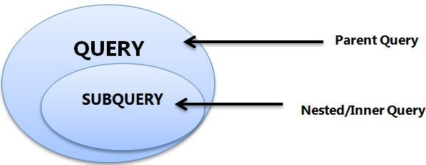
- A subquery must be enclosed in parentheses.
- Use single-row operators with single-row subqueries, and use multiple-row operators with multiple-row subqueries.
- If a subquery (inner query) returns a null value to the outer query, the outer query will not return any rows when using certain comparison operators in a WHERE clause.
Sub-Queries
You may use comparison operators such as <>, <, >, <=, and >= with a single row subquery.
Multiple row subquery returns one or more rows to the outer SQL statement. You may use the IN, ANY, or ALL operator in outer query to handle a subquery that returns multiple rows.

Slide 227
If ORDER BY occurs within a subquery and also is applied in the outer query, the outermost ORDER BY takes precedence.
(SELECT ... ORDER BY a) ORDER BY a DESC;
If LIMIT occurs within a subquery and also is applied in the outer query, the outermost LIMIT takes precedence.
(SELECT ... LIMIT 1) LIMIT 2;
Sub-Queries

Slide 228

Single Row Subqueries
A single row subquery returns zero or one row to the outer SQL statement. You can place a subquery in a WHERE clause, a HAVING clause, or a FROM clause of a SELECT statement.
Outer Query
Subquery or Inner query

Slide 229

Multiple Row and Column Subqueries
A multiple row subquery returns one or more rows to the outer SQL statement. You may use the IN, ANY, or ALL operator in outer query to handle a subquery that returns multiple rows.
Outer Query
Subquery or Inner query

Slide 230
Subqueries
A subquery is a SELECT statement within another statement.
A subquery may occur in:
A SELECT clause
A FROM clause
A WHERE clause
A HAVING clause
A subquery's outer statement can be any one of: SELECT, INSERT, UPDATE, DELETE, SET, or DO.

Slide 231

Subqueries with INSERT
syntax
INSERT INTO table_name [ (column1 [, column2 ]) ]
SELECT [ *|column1 [, column2 ] FROM table1 [, table2 ]
[ WHERE VALUE OPERATOR ];

Slide 232
Subqueries with UPDATE
syntax
UPDATE table_name SET column_name = new_value [ WHERE OPERATOR [ VALUE ] (SELECT column_name FROM table_name) [ WHERE) ]

Slide 233
Subqueries with DELETE
syntax
DELETE FROM table_name [ WHERE OPERATOR [ VALUE ]
(SELECT column_name FROM table_name) [ WHERE) ]

Slide 234
Types of Subqueries
Types of Subqueries
The Subquery as Scalar Operand
Comparisons using Subqueries
Subqueries in the FROM Clause (Inline Views)
Subqueries with ALL, ANY, IN, or SOME
Row Subqueries
Subqueries with EXISTS or NOT EXISTS
Correlated Subqueries

Slide 235
The Subquery as Scalar Operand

Slide 236
The Subquery as Scalar Operand
A scalar subquery is a subquery that returns exactly one column value from one row. A scalar subquery is a simple operand, and you can use it almost anywhere a single column value is legal.
If the subquery returns 0 rows then the value of scalar subquery expression is NULL.
if the subquery returns more than one row then MySQL returns an ERROR.
SELECT (SELECT 1, 2) ; // error
SELECT (SELECT ename, sal FROM EMP); // error
SELECT (SELECT * FROM EMP); // error
SELECT (SELECT NULL + 1);
SELECT ENAME, (SELECT DNAME FROM DEPT WHERE EMP.DEPTNO = DEPT.DEPTNO) R1 FROM EMP ;

Slide 237
Comparisons using Subquery

Slide 238
Comparisons using Subqueries
A subquery can be used before or after any of the comparison operators. The subquery can return at most one value. The value can be the result of an arithmetic expression or a column function. SQL then compares the value with the value on the other side of the comparison operator.
SELECT * FROM EMP where deptno = (SELECT deptno FROM DEPT where deptno in (10, 20));
SELECT * FROM EMP WHERE DEPTNO = (SELECT 5 + 5);
SELECT * FROM EMP WHERE SAL = (SELECT MAX(SAL) FROM EMP);
Comparison Functions and Operators
= | Equal operator
> | Greater than operator
>= | Greater than or equal operator
< | Less than operator
<= | Less than or equal operator
!=, <> | Not equal operator
<=> | NULL-safe equal to operator

Slide 239
Subquery in the FROM Clause

Slide 240
Subqueries in the FROM Clause
Subqueries work in a SELECT statement's FROM clause.
SELECT ... FROM (subquery) [AS] name ...
Every table in a FROM clause must have a name, therefore the [AS] name clause is mandatory.
SET @x :=0;
SELECT * FROM (SELECT @x := @x + 1 as R1, EMP.* FROM EMP) E
WHERE R1 = 5;
SELECT * FROM (SELECT @cnt := @cnt + 1 R1, mod(@cnt,2) R2, EMP.* FROM EMP, (SELECT @cnt:=0) E ) E1 WHERE R2=0;
SELECT MIN(R1) FROM (SELECT COUNT(JOB) R1 FROM EMP GROUP BY JOB) E;

Slide 241
Subquery with IN, ALL, ANY, or SOME

Slide 242
Subqueries with IN, ALL, ANY, or SOME
You can use a subquery after a comparison operator, followed by the keyword IN, ALL, ANY, or SOME.
SELECT * FROM EMP WHERE DEPTNO IN (SELECT DEPTNO FROM EMP WHERE DEPTNO = 10 or DEPTNO = 20);
SELECT * FROM EMP WHERE SAL >ALL (SELECT SAL FROM EMP WHERE ENAME = 'ADAMS' or ENAME = 'TURNER');
SELECT * FROM EMP WHERE SAL >ANY (SELECT SAL FROM EMP WHERE ENAME = 'ADAMS' or ENAME = 'TURNER');
SELECT * FROM EMP WHERE SAL >SOME (SELECT SAL FROM EMP WHERE ENAME = 'ADAMS' or ENAME = 'TURNER');

Slide 243
Subqueries with IN, ALL, ANY, or SOME
operand comparison_operator ANY (subquery)
operand IN (subquery)
operand comparison_operator SOME (subquery)
operand comparison_operator ALL (subquery)
The word SOME is an alias for ANY.
The ANY keyword, which must follow a comparison operator, means return TRUE if the comparison is TRUE for ANY of the values in the column that the subquery returns.
The word ALL, which must follow a comparison operator, means return TRUE if the comparison is TRUE for ALL of the values in the column that the subquery returns.
IN and =ANY are not synonyms when used with an expression list. IN can take an expression list, but = ANY cannot.

Slide 244
Subqueries with ANY / SOME
"x = ANY (...)": The value must match one or more values in the list to evaluate to TRUE.
"x != ANY (...)": The value must not match one or more values in the list to evaluate to TRUE.
"x > ANY (...)": The value must be greater than the smallest value in the list to evaluate to TRUE.
"x < ANY (...)": The value must be smaller than the biggest value in the list to evaluate to TRUE.
"x >= ANY (...)": The value must be greater than or equal to the smallest value in the list to evaluate to TRUE.
"x <= ANY (...)": The value must be smaller than or equal to the biggest value in the list to evaluate to TRUE.
The word SOME is an alias for ANY.

Slide 245
Subqueries with ALL
"x = ALL (...)": The value must match all the values in the list to evaluate to TRUE.
"x != ALL (...)": The value must not match any values in the list to evaluate to TRUE.
"x > ALL (...)": The value must be greater than the biggest value in the list to evaluate to TRUE.
"x < ALL (...)": The value must be smaller than the smallest value in the list to evaluate to TRUE.
"x >= ALL (...)": The value must be greater than or equal to the biggest value in the list to evaluate to TRUE.
"x <= ALL (...)": The value must be smaller than or equal to the smallest value in the list to evaluate to TRUE.

Slide 246
Row Subquery

Slide 247
Row Subqueries
Scalar or column Subqueries return a single value or a column of values. A row subquery is a subquery variant that returns a single row and can thus return more than one column value. You can use = , >, <, >=, <=, <>, !=, <=>
SELECT * from EMP where deptno, 1 = (SELECT deptno, 1 from DEPT where deptno=10);
SELECT * FROM EMP WHERE ROW (DEPTNO, 1) = (SELECT DEPTNO, 1 FROM DEPT WHERE DEPTNO = 10);

Slide 248
Subquery with EXISTS or NOT EXISTS

Slide 249
Subqueries with EXISTS or NOT EXISTS
The EXISTS operator tests for the existence of rows in the results set of the subquery. If a subquery row value is found, EXISTS subquery is TRUE and in this case NOT EXISTS subquery is FALSE.
SELECT * FROM EMP WHERE EXISTS (SELECT * FROM DEPT WHERE EMP.DEPTNO = DEPT.DEPTNO);
SELECT * FROM EMP WHERE NOT EXISTS (SELECT DEPTNO FROM EMP WHERE EMP.DEPTNO = DEPT.DEPTNO);
SELECT * FROM EMP M WHERE EXISTS (SELECT * FROM EMP E WHERE E.MGR = M.EMPNO);
SELECT * FROM EMP M WHERE NOT EXISTS (SELECT * FROM EMP E WHERE E.MGR = M.EMPNO);

Slide 250
Correlated Subquery

Slide 251
Correlated Subqueries
A correlated subquery (also known as a synchronized subquery) is a subquery that uses values from the outer query. The subquery is evaluated once for each row processed by the outer query.
Following query find all employees who earn more than the average salary in their department.
SELECT * FROM EMP E WHERE SAL > (SELECT AVG(SAL) FROM EMP WHERE E.DEPTNO = EMP.DEPTNO) ORDER BY DEPTNO;
SELECT ENAME, SAL, JOB FROM EMP WHERE SAL > (SELECT AVG(SAL) FROM EMP E WHERE E.JOB = EMP.JOB);
SELECT JOB, MAX(SAL) FROM EMP WHERE SAL < (SELECT MAX(SAL) FROM EMP E WHERE EMP.JOB = E.JOB GROUP BY E.JOB) GROUP BY JOB;
SELECT DISTINCTROW DEPTNO FROM EMP WHERE EXISTS (SELECT DEPTNO FROM DEPT WHERE EMP.DEPTNO = DEPT.DEPTNO); (Intersect)
SELECT DISTINCTROW DEPTNO FROM DEPT WHERE NOT EXISTS (SELECT DEPTNO FROM EMP WHERE EMP.DEPTNO = DEPT.DEPTNO);

Slide 252
JOINS

Slide 253
JOINS
JOINS are used to retrieve data from multiple tables.
JOIN is performed whenever two or more tables are joined in a SQL statement.

Slide 254
JOINS
Cartesian or Product Join – Cross Join
Equijoin – Inner Join
Natural Join
Simple Join
Outer Join – Right Outer Join, Left Outer Join
Self Join

Slide 255

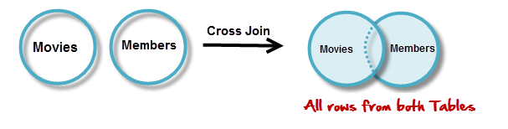

JOINS - Cartesian or Product
Cartesian or Product joins are joins without a join condition. Each row of one table is combined with each row of another table. The result is referred to as a Cartesian product.
SELECT column-list from <table_references>, <table_references>

Slide 256

JOINS – Cross Join
The CROSS JOIN produced a result set which is the product of rows of two associated tables when no WHERE clause is used with CROSS JOIN. In this join, the result set appeared by multiplying each row of the first table with all rows in the second table if no condition introduced with CROSS JOIN.
SELECT column-list from <table_references> CROSS JOIN <table_references>
SELECT * FROM EMP CROSS JOIN DEPT;

Slide 257
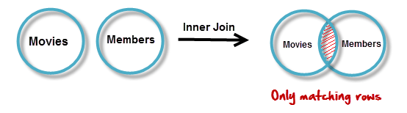

JOINS – equi join
EQUI JOIN performs a JOIN against equality or matching column(s) values of the associated tables. An equal sign (=) is used as comparison operator in the where clause to refer equality.
SELECT column-list from <table_references>, <table_references> WHERE table1.column-name = table2.column-name
SELECT * FROM EMP, DEPT WHERE EMP.DEPTNO = DEPT.DEPTNO
`
JOINING CONDITION

Slide 258
Display how many employees are working from every department?
Display the department name where less the 3 employees are working?

Slide 259
ON Contrition
When this join condition gets applied none of the columns of the relation will get eliminated in the result set.
In order to apply this join condition, on any two tables they need not to have any common column.
ON condition and USING Attribute
USING Attribute Contrition
When all the common columns are used in the join predicate then the result would be same as Natural join.
In the result set of the join the duplicates of the columns used in the predicate gets eliminated.

Slide 260

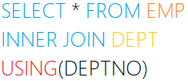
JOINS – USING & ON clause
The ON clause
The ON clause is used to join tables where the column names don’t match in both tables.
JOINING CONDITION
The USING clause
The USING clause is used if several columns share the same name but you don’t want to join using all of these common columns. The columns listed in the USING clause can’t have any qualifiers in the statement.
JOINING CONDITION

Slide 261
JOINS – Inner Join
Inner join returns rows when there is at least one match in both tables.
The INNER JOIN selects all rows from both participating tables as long as there is a match between the columns. An SQL INNER JOIN is same as JOIN clause, combining rows from two or more tables.
SELECT column-list from <table_references> [INNER] JOIN <table_references> ON table1.column-name = table2.column-name
SELECT * FROM EMP INNER JOIN DEPT ON EMP.DEPTNO = DEPT.DEPTNO
SELECT column-list from <table_references> [INNER] JOIN <table_references> USING (column-name)
SELECT * FROM EMP INNER JOIN DEPT USING (DEPTNO)

Slide 262

JOINS – Natural Join
Joins two tables based on common column names. Hence one must confirm the common columns before using a NATURAL JOIN
The NATURAL JOIN is such a join that performs the same task as an INNER JOIN.
SELECT column-list from <table_references> NATURAL JOIN <table_references> NATURAL JOIN <table_references>
SELECT * FROM EMP NATURAL JOIN DEPT
The associated tables have one or more pairs of identically column-names.
The columns must be of the same data type.
Don't use ON / USING clause in a NATURAL JOIN.
When this join condition gets applied always the duplicates of the common columns get eliminated from the result.
A NATURAL JOIN can be used with a LEFT OUTER join, or a RIGHT OUTER join.
If the column-names are not same, then NATURAL JOIN will work as CROSS JOIN.

Slide 263
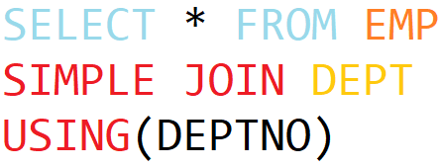
JOINS – Simple Join
The SIMPLE JOIN is such a join that performs the same task as an INNER JOIN.
SELECT column-list from <table_references> SIMPLE JOIN <table_references> USING (column-list)
SELECT * FROM EMP SIMPLE JOIN DEPT USING(DEPTNO)
JOINING CONDITION

Slide 264
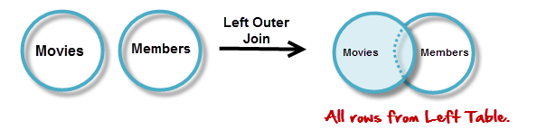


JOINS – Left Outer Join
JOINING CONDITION

Slide 265
JOINS – Left Outer Join
The LEFT JOIN keyword returns all rows from the left table (table1), with the matching rows in the right table (table2). The result is NULL in the right side when there is no match.
SELECT column-list from <table_references> LEFT [OUTER ] JOIN <table_references> ON table1.column-name = table2.column-name
SELECT * FROM EMP LEFT OUTER JOIN DEPT ON EMP.DEPTNO = DEPT.DEPTNO;
SELECT column-list from <table_references> LEFT [OUTER ] JOIN <table_references> USING (column-name)
SELECT * FROM EMP LEFT OUTER JOIN DEPT USING(DEPTNO);
SELECT column-list from <table_references> NATURAL LEFT [OUTER ] JOIN <table_references>
SELECT * FROM EMP NATURAL LEFT OUTER JOIN DEPT;

Slide 266
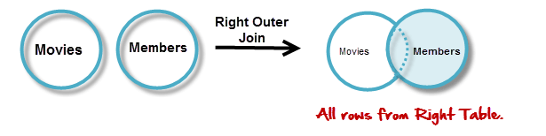


JOINS – Right Outer Join
JOINING CONDITION

Slide 267
JOINS – Right Outer Join
The RIGHT JOIN keyword returns all rows from the right table (table2), with the matching rows in the left table (table1). The result is NULL in the left side when there is no match.
SELECT column-list from <table_references> RIGHT [OUTER ] JOIN <table_references> ON table1.column-name = table2.column-name
SELECT * FROM EMP RIGHT OUTER JOIN DEPT ON EMP.DEPTNO = DEPT.DEPTNO;
SELECT column-list from <table_references> RIGHT [OUTER ] JOIN <table_references> USING (column-name)
SELECT * FROM EMP RIGHT OUTER JOIN DEPT USING(DEPTNO);
SELECT column-list from <table_references> NATURAL RIGHT [OUTER ] JOIN <table_references>
SELECT * FROM EMP NATURAL RIGHT OUTER JOIN DEPT;

Slide 268
JOINS – Self Join
A self join is a join in which a table is joined with itself (which is also called Unary relationships), especially when the table has a FOREIGN KEY which references its own PRIMARY KEY.
SELECT a.column_name, b.column_name... FROM table1 a, table1 b WHERE a.common_name = b.common_name;

Slide 269


UNION: To apply ORDER BY or LIMIT to an individual SELECT, place the clause inside the parentheses that enclose the SELECT.
E.g. (SELECT …) UNION (SELECT …)
Set Operation in SQL

Slide 270
UNION
The UNION operator is used to combine the result sets of 2 or more SELECT statements. It removes duplicate rows between the various SELECT statements. Each SELECT statement within the UNION operator must have the same number of fields in the result sets.
The default behaviour for UNION is that duplicate rows are removed from the result.
SELECT ... UNION [ALL | DISTINCT] SELECT ... [UNION [ALL | DISTINCT] SELECT ...]
SELECT DEPTNO FROM EMP UNION SELECT DEPTNO FROM DEPT;
SELECT DEPTNO FROM EMP UNION ALL SELECT DEPTNO FROM DEPT;
(SELECT DEPTNO FROM EMP LIMIT 1) UNION (SELECT DEPTNO FROM DEPT LIMIT 1);
SELECT 'EMP' as 'Table Name', count(*) FROM EMP UNION SELECT 'DEPT', count(*) FROM DEPT UNION SELECT 'BONUS', count(*) FROM BONUS;

Slide 271
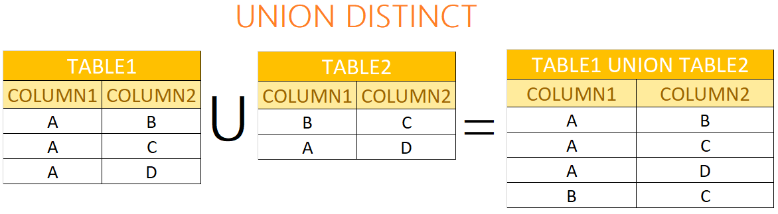
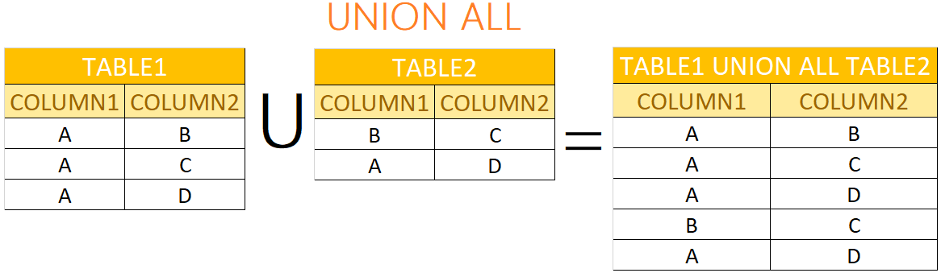
UNION & UNION ALL

Slide 272
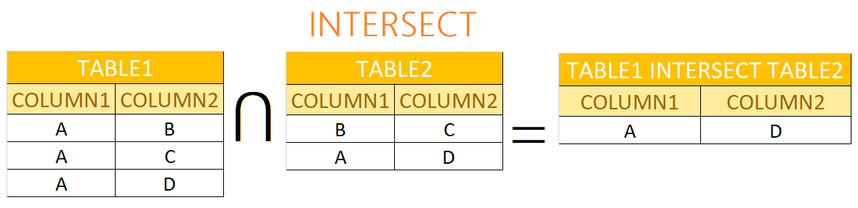
INTERSECT
An INTERSECT query returns the intersection of 2 or more datasets. If a record exists in both data sets, it will be included in the INTERSECT results.
There is no INTERSECT operator in MySQL, you can easily simulate this type of query using either the IN clause or the EXISTS clause.
SELECT * FROM EMP WHERE DEPTNO IN (SELECT DEPTNO FROM DEPT);
SELECT * FROM EMP WHERE EXISTS (SELECT DEPTNO FROM DEPT WHERE EMP.DEPTNO = DEPT.DEPTNO);

Slide 273
MINUS
The MINUS operator takes the distinct rows of one query and returns the rows that do not appear in a second result set.
There is no MINUS operator in MySQL, you can easily simulate this type of query using either the NOT IN clause or the NOT EXISTS clause.
SELECT * FROM DEPT WHERE DEPTNO NOT IN (SELECT DEPTNO FROM EMP);
SELECT * FROM DEPT WHERE NOT EXISTS (SELECT DEPTNO FROM EMP WHERE EMP.DEPTNO = DEPT.DEPTNO);

Slide 274
CREATE TABLE ... LIKE STATEMENT

Slide 275
CREATE TABLE ... LIKE
Use CREATE TABLE ... LIKE to create an empty table based on the definition of another table, including any column attributes and indexes defined in the original table.
CREATE TABLE [IF NOT EXISTS] new_tbl LIKE orig_tbl;
LIKE works only for base tables, not for VIEWS.
You cannot execute CREATE TABLE or CREATE TABLE ... LIKE while a LOCK TABLES statement is in effect.
CREATE TABLE E like EMP;

Slide 276
CREATE TEMPORARY TABLE ... LIKE STATEMENT

Slide 277
CREATE TEMPORARY TABLE ... LIKE
Use CREATE TABLE ... LIKE to create an empty table based on the definition of another table.
CREATE TEMPORARY TABLE [IF NOT EXISTS] new_tbl LIKE orig_tbl;
LIKE works only for base tables, not for VIEWS.
You cannot execute CREATE TABLE or CREATE TABLE ... LIKE while a LOCK TABLES statement is in effect.
You can use the TEMPORARY keyword when creating a table. A TEMPORARY table is visible only to the current session, and is dropped automatically when the session is closed.
CREATE TEMPORARY TABLE E like EMP;
Use TEMPORARY table with the same name as the original can be useful when you want to try some statements that modify the contents of the table, without changing the original table.

Slide 278
CREATE TABLE ... SELECT STATEMENT

Slide 279
CREATE TABLE ... SELECT
You can create one table from another by adding a SELECT statement at the end of the CREATE TABLE statement.
CREATE TABLE new_tbl [AS] SELECT * FROM orig_tbl;
You cannot use FOR UPDATE as part of the SELECT in a statement such as CREATE TABLE new_table SELECT ... FROM old_table .... FOR UPDATE.
If you attempt to do so, the statement fails.
CREATE TABLE E SELECT * FROM EMP;
CREATE TABLE E AS SELECT * FROM EMP;
CREATE TABLE E (ID INT) SELECT * FROM EMP;
CREATE TABLE E AS SELECT 1+1, ENAME FROM EMP;
CREATE TABLE E AS SELECT 1+1 R1, ENAME FROM EMP;
CREATE TABLE E AS SELECT * FROM EMP WHERE 1=2;
By default, this statement does not copy all column attributes such as AUTO_INCREMET

Slide 280
Commit and Rollback

Slide 281
Commit and Rollback
To undo MySQL statements you use the ROLLBACK statement. To write the changes into the database within a transaction, you use the COMMIT statement.
START TRANSACTION
[transaction_characteristic]
transaction_characteristic:
| READ WRITE
| READ ONLY
It is important to note that MySQL automatically commits the changes to the database by default.
START TRANSACTION READ ONLY;
INSERT DEPT values (60, 'HRD', 'Pune' );
COMMIT

Slide 282
Commit and Rollback
To undo MySQL statements you use the ROLLBACK statement. To write the changes into the database within a transaction, you use the COMMIT statement.
BEGIN [WORK]
COMMIT [WORK]
ROLLBACK [WORK]
SET autocommit = {0 | 1}
It is important to note that MySQL automatically commits the changes to the database by default.
BEGIN WORK
INSERT DEPT VALUES (60, 'HRD', 'Pune' );
COMMIT WORK
SET autocommit = {0 | 1} 0 - disable; 1 - enable
SELECT @@AUTOCOMMIT;

Slide 283
Anomalies in DBMS
There are three types of anomalies that occur when the database is not normalized. These are – Insertion, update and deletion anomaly.

Slide 284
Anomalies in DBMS - Example
Suppose a manufacturing company stores the employee details in a table named EMP that has following attributes: ID, FIRSTNAME, ADDRESS, and DEPTNO for storing department details in which the employee works.
ID | FIRSTNAME | ADDRESS | DEPTNO (NN)
1 | RAMESH | PUNE | 10
1 | RAMESH | PUNE | 20
2 | NILESH | BARODA | 10
3 | KAMLESH | SURAT | 20
3 | KAMLESH | SURAT | 30
4 | RAJESH | MUMBAI | 10

Slide 285
INSERT, UPDATE, and DELETE ANOMALY
Insert anomaly: Suppose a new employee joins the company, who is under training and currently not assigned to any department then we would not be able to insert the data into the table if DEPTNO field doesn’t allow nulls.
Update anomaly: In the above table EMP we have two rows for employee RAMESH as he belongs to two departments of the company. If we want to update the address of RAMESH then we have to update the same in two rows or the data will become inconsistent. If somehow, the correct address gets updated in one department but not in other then as per the database, RAMESH would be having two different addresses, which is not correct and would lead to inconsistent data.
Delete anomaly: Suppose, if at a point of time the company closes the department 20 then deleting the rows that are having DEPTNO as 20 would also delete the information of employee Maggie since she is assigned only to this department.

Slide 286
INSERT ROWS using VALUES

Slide 287
INSERT … VALUES
INSERT inserts new rows into an existing table. The INSERT ... VALUES
INSERT [INTO] tbl_name [(col_name,...)] {VALUES | VALUE} ({expr | DEFAULT}, ...) , (...), ... [ON DUPLICATE KEY UPDATE assignment_list]
The affected-rows value for an INSERT can be obtained using the ROW_COUNT() function.
Column Values
Column List
Multiple rows

Slide 288
INSERT ROWS using SET

Slide 289
DML- INSERT …SET
INSERT inserts new rows into an existing table. The INSERT ... SET forms of the statement insert rows based on explicitly specified values.
INSERT [INTO] tbl_name SET col_name={expr | DEFAULT}, ... [ON DUPLICATE KEY UPDATE assignment_list]
The affected-rows value for an INSERT can be obtained using the ROW_COUNT() function.
A SET clause indicates columns explicitly by name, together with the value to assign each one.

Slide 290
INSERT ROWS using ON DUPLICATE KEY

Slide 291
DML- INSERT …ON DUPLICATE KEY
If you specify an ON DUPLICATE KEY UPDATE clause and a row to be inserted would cause a duplicate value in a UNIQUE index or PRIMARY KEY, an UPDATE of the old row occurs.
INSERT [INTO] tbl_name [(col_name,...)] {VALUES | VALUE} ({expr | DEFAULT}, ...) , (...), ... ON DUPLICATE KEY UPDATE
CREATE TABLE TEMP (a int primary key, b int, c int);
INSERT INTO TEMP VALUES (1,2,3), (4,5,6) ON DUPLICATE KEY UPDATE c = 10+10;
INSERT INTO TEMP VALUES (1,2,3), (4,5,6) ON DUPLICATE KEY UPDATE c= a + b;
INSERT INTO TEMP VALUES (1,2,3), (4,5,6) ON DUPLICATE KEY UPDATE c = VALUES(a) + VALUES(b);

Slide 292
INSERT ROWS using SELECT

Slide 293
INSERT ... SELECT
With INSERT ... SELECT, you can quickly insert many rows into a table from one or many tables.
INSERT [INTO] tbl_name [(col_name,...)] SELECT ... [ON DUPLICATE KEY UPDATE assignment_list]
INSERT INTO DEPT (DEPTNO) SELECT 1 + 1;
INSERT INTO DEPT (DEPTNO) SELECT DEPTNO FROM DEPT;
INSERT INTO DEPT SELECT * FROM DEPT;
INSERT INTO DEPT (SELECT MAX(DEPTNO) + 1, 'HRD', 'BARODA', 'r57px33px' FROM DEPT);
set @x := 40;
INSERT INTO DEPT VALUES (@x := @x + 1 , 'HRD', 'BARODA', 'r57px33px');

Slide 294
REPLACE using VALUES

Slide 295
REPLACE … VALUES
REPLACE works exactly like INSERT, except that if an old row in the table has the same value as a new row for a PRIMARY KEY or a UNIQUE index, the old row is deleted before the new row is inserted.
REPLACE [INTO] tbl_name [(col_name,...)] {VALUES | VALUE} ({expr | DEFAULT}, ...), (...),...
REPLACE makes sense only if a table has a PRIMARY KEY or UNIQUE index. Otherwise, it becomes equivalent to INSERT, because there is no index to be used to determine whether a new row duplicates another.
REPLACE INTO DEPT VALUES (10,'HRD','BARODA');
REPLACE INTO DEPT VALUES (50,'RESEARCH','DALLAS');
REPLACE INTO DEPT(DEPTNO, DNAME) VALUE (60,‘New Data');

Slide 296
REPLACE using SET

Slide 297
REPLACE … SET
REPLACE works exactly like INSERT, except that if an old row in the table has the same value as a new row for a PRIMARY KEY or a UNIQUE index, the old row is deleted before the new row is inserted.
REPLACE [INTO] tbl_name SET col_name = {expr | DEFAULT}, ...
REPLACE makes sense only if a table has a PRIMARY KEY or UNIQUE index. Otherwise, it becomes equivalent to INSERT, because there is no index to be used to determine whether a new row duplicates another.
REPLACE INTO DEPT SET DNAME='HRD', LOC='BARODA', DEPTNO=10;
REPLACE INTO DEPT SET DNAME='HRD', LOC='BARODA', DEPTNO=50;

Slide 298
REPLACE using SELECT

Slide 299
REPLACE … SELECT
REPLACE works exactly like INSERT, except that if an old row in the table has the same value as a new row for a PRIMARY KEY or a UNIQUE index, the old row is deleted before the new row is inserted.
REPLACE [INTO] tbl_name [(col_name,...)] SELECT ...
REPLACE makes sense only if a table has a PRIMARY KEY or UNIQUE index. Otherwise, it becomes equivalent to INSERT, because there is no index to be used to determine whether a new row duplicates another.
REPLACE INTO TEMP SELECT * FROM DEPT;
REPLACE INTO TEMP SELECT * FROM REPLACEDEPT;
REPLACE INTO TEMP (DEPTNO, DNAME) SELECT DEPTNO, DNAME FROM DEPT;

Slide 300
Single-table UPDATE
ORDER BY in UPDATE: if the table contains 1 and 2 in the id column and 1 is updated to 2 before 2 is updated to 3, an error occurs. To avoid this problem, add an ORDER BY clause to cause the rows with larger id values to be updated before those with smaller values
UPDATE TEMP SET C1 = C1 + 1 ORDER BY C1 DESC;

Slide 301
Single-table UPDATE
The UPDATE statement updates columns of existing rows in the named table with new values. The SET clause indicates which columns to modify and the values they should be given. The WHERE clause, if given, specifies the conditions that identify which rows to update. With no WHERE clause, all rows are updated. If the ORDER BY clause is specified, the rows are updated in the order that is specified. The LIMIT clause places a limit on the number of rows that can be updated.
UPDATE <table_reference> SET col_name1 = {expr1 | DEFAULT} [, col_name2 = {expr2 | DEFAULT}] ...
[WHERE where_condition]
[ORDER BY ...]
[LIMIT row_count]
UPDATE TEMP SET dname='xyz' LIMIT 2;
UPDATE TEMP SET c1='x' ORDER BY loc LIMIT 2;
UPDATE TEMP SET c1 = 'x' WHERE deptno <50;
UPDATE TEMP SET c1 = 'x' WHERE deptno <50 LIMIT 2;

Slide 302
Multiple-table UPDATE

Slide 303
Multiple-table UPDATE
The multiple-table UPDATE updates rows in each table named in table_references that satisfy the conditions. Each matching row is updated once, even if it matches the conditions multiple times.
UPDATE table_references SET col_name1 = {expr1|DEFAULT} [, col_name2 = {expr2|DEFAULT}] ...
[WHERE where_condition]
For multiple-table syntax, ORDER BY and LIMIT cannot be used.
UPDATE EMP, DEPT SET EMP.pwd = DEPT.pwd WHERE EMP.deptno = DEPT.deptno;
UPDATE EMP, DEPT SET EMP.pwd = DEPT.pwd, DEPT.loc=‘New Data' WHERE EMP.deptno = DEPT.deptno;

Slide 304
Single-Table DELETE

Slide 305
Single-table DELETE
The DELETE statement deletes rows from tbl_name and returns the number of deleted rows. To check the number of deleted rows, call the ROW_COUNT() function. The optional WHERE clause identify which rows to delete. With no WHERE clause, all rows are deleted. If the ORDER BY clause is specified, the rows are deleted in the order that is specified. The LIMIT clause places a limit on the number of rows that can be deleted.
DELETE FROM table_reference
[WHERE where_condition]
[ORDER BY ...]
[LIMIT row_count]
LIMIT clauses apply to single-table deletes, but not multi-table deletes.
DELETE FROM TEMP;
DELETE FROM TEMP ORDER BY LOC LIMIT 2;
DELETE FROM TEMP WHERE DEPTNO <50;
DELETE FROM TEMP WHERE DEPTNO <50 LIMIT 2;

Slide 306
Multiple-table DELETE

Slide 307
Multiple-table DELETE
You can specify multiple tables in a DELETE statement to delete rows from one or more tables depending on the condition in the WHERE clause.
DELETE FROM tbl_name [, tbl_name] ...
USING <table_references>
[WHERE where_condition]
You cannot use ORDER BY or LIMIT in a multiple-table DELETE.
DELETE FROM A, B USING A INNER JOIN B ON c2=c4;
DELETE FROM A, B USING A INNER JOIN B ON c2=c4 WHERE c2<=2;

Slide 308
The char is a fixed-length character data type,
The varchar is a variable-length character data type.
Natural numbers are the set of positive integers, that is, integers from 1 to ∞ excluding fractional n decimal part. They are whole numbers excluding zero. Natural Numbers are also called counting numbers. Zero is the only whole number which is not a natural number.
Datatypes
ENAME CHAR (10) | S | A | L | E | E | L |  |  |  |  | LENGTH -> 10
ENAME VARCHAR(10) | S | A | L | E | E | L |  |  |  |  | LENGTH -> 6
When CHAR values are retrieved, the trailing spaces are removed (unless the PAD_CHAR_TO_FULL_LENGTHSQL mode is enabled)
In MySQL
ENAME CHAR (10) | S | A | L | E | E | L |  |  |  |  | LENGTH -> 6
ENAME VARCHAR(10) | S | A | L | E | E | L |  |  |  |  | LENGTH -> 6

Slide 309
dataType - STRING
MySQL supports a number of SQL data types in several categories: numeric types, date and time types, string.
Datatypes | Size | Description
CHAR [(length)] | 0-255
VARCHAR (length) | 0-65535
TINYTEXT [(length)] | (2⁸ − 1) bytes
TEXT [(length)] | (2¹⁶ -1) bytes
MEDIUMTEXT [(length)] | (2²⁴ -1) bytes
LONGTEXT [(length)] | (2³² -1) bytes
ENUM('value1', 'value2',...) | 65,535 members
SET('value1', 'value2',...) | 64 members
By default, trailing spaces are trimmed from CHAR column values on retrieval. If PAD_CHAR_TO_FULL_LENGTH is enabled, trimming does not occur and retrieved CHAR values are padded to their full length.
SET sql_mode = '';
SET sql_mode = 'PAD_CHAR_TO_FULL_LENGTH';

Slide 310
dataType – ENUM
An ENUM column can have a maximum of 65,535 distinct elements.
ENUM values are sorted based on their index numbers, which depend on the order in which the enumeration members were listed in the column specification.
Default value, NULL if the column can be NULL, first enumeration value if NOT NULL
CREATE TABLE TEMP (COL1 INT, COL2 ENUM('A','B','C') NULL);
INSERT INTO TEMP (COL1) VALUES (1);
CREATE TABLE TEMP (COL1 INT, COL2 ENUM('A','B','C') NOT NULL);
INSERT INTO TEMP (COL1) VALUES (1);
CREATE TABLE TEMP (COL1 INT, COL2 ENUM('') NOT NULL);
INSERT INTO TEMP (COL1) VALUES (1,'THIS IS THE TEST');
You also cannot user variable as an enumeration value. This pair of statements do not work:
SET @mysize = 'medium';
CREATE TABLE sizes ( size ENUM('small', @mysize, 'large'));

Slide 311
dataType – SET
A SET column can have a maximum of 64 distinct members.
A SET is a string object that can have zero or more values, each of which must be chosen from a list of permitted values specified when the table is created.
SET column values that consist of multiple set members are specified with members separated by commas (,).
CREATE TABLE TEMP (col SET('a', 'b', 'c', 'd'));
INSERT INTO TEMP (col) VALUES ('a,d'), ('d,a'), ('a,d,a'), ('a,d,d'), ('d,a,d');

Slide 312
dataType - NUMERIC
MySQL supports a number of SQL data types in several categories: numeric types, date and time types, string.
Datatypes | Size | Description
TINYINT [(length)] | 1 byte | -128 to +127
SMALLINT [(length)] | 2 bytes | -32,768 to +32,767
MEDIUMINT [(length)] | 3 bytes | -8,388,608 to 8,388,607
INT, INTEGER [(length)] | 4 bytes | -2,147,483,648 to +2,147,483,647
BIGINT [(length)] | 8 bytes | -9,223,372,036,854,775,808 to 9,223,372,036,854,775,807
FLOAT [(length[,decimals])] | 4 bytes
DECIMAL [(length[,decimals])], NUMERIC [(length[,decimals])] |  | NUMERIC will get converted in DECIMAL
DOUBLE [PRECISION] [(length[,decimals])], REAL [(length[,decimals])] | 8 bytes
For: float(M,D), double(M,D) or decimal(M,D), M must be >= D

Slide 313
dataType – DATE and TIME
MySQL supports a number of SQL data types in several categories: numeric types, date and time types, string.
Datatypes | Size | Description
YEAR | 1 byte
DATE | 3 bytes
TIME | 3 bytes
DATETIME | 8 bytes | '1000-01-01 00:00:00' to '9999-12-31 23:59:59'
TIMESTAMP | 4 bytes | '1970-01-01 00:00:01' to '2038-01-19 03:14:07'

Slide 314
dataType – Boolean
BOOL and BOOLEAN are synonym of TYNYINT(1)
CREATE TABLE TEMP (COL1 int ,COL2 bool, COL3 boolean);
DESCRIBE TEMP;
INSERT INTO T VALUES (1, TRUE ,FALSE);
SELECT * FROM TEMP;

Slide 315
JSON Datatype

Slide 316
Datatype – JSON
JSON (JavaScript Object Notation) documents.
Data is in name/value pairs
Data is separated by comm
Curly braces hold objects
Square brackets hold arrays

Slide 317
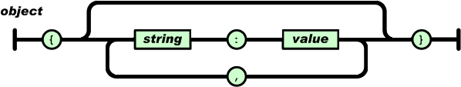
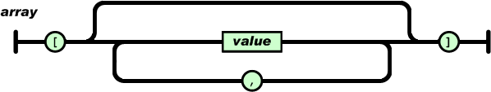
An object is an unordered set of name/value pairs.
An array is an ordered collection of values.

Slide 318
JSON
Returns data from a JSON document, selected from the parts of the document matched by the path arguments. Returns NULL if any argument is NULL or no paths locate a value in the document. An error occurs if the json_doc argument is not a valid JSON document or any path argument is not a valid path expression.
JSON_EXTRACT(json_doc, path[, path] ...)
SELECT ('[10, 20, [30, 40], [50, 60, 70]]');
SELECT JSON_EXTRACT('[10, 20, [30, 40], [50, 60, 70]]', '$[0]');
SELECT JSON_EXTRACT('[10, 20, [30, 40], [50, 60, 70]]', '$[3][0]');
SELECT JSON_EXTRACT('[10, 20, [30, 40]]', '$[0]', '$[1]');
SELECT ('{"id" : "1001", "ename" : "saleel"}');
SELECT ('[ {"id" : "1001“ ,"ename" : "saleel"}, {"id" : "1002", "ename" : "sharmin", "mob" : "12345"} ]');
SELECT JSON_EXTRACT('{"id" : "1001", "ename" : "saleel"}', '$.ename');

Slide 319
Datatype – JSON … (Insert)
MySQL supports a native JSON data type that enables efficient access to data in JSON (JavaScript Object Notation) documents.
CREATE table E (c1 json);
INSERT into E VALUES ('{}');
INSERT into E VALUES ('{"empno" : "1001", "ename" : "saleel", "phone" : [123,456]}');
INSERT into E VALUES ('{"empno" : "1002", "ename" : "sharmin" ,"phone" : [9922,8811], "address" : "Paud Road"}');
INSERT into E VALUES ('{"empno" : "1003", "ename" : "vrushali", "phone" : [7788,9977], "address" : {"city" : "Pune", "state" : "MH"}}');

Slide 320
Datatype – JSON … (Select)
MySQL supports a native JSON data type that enables efficient access to data in JSON (JavaScript Object Notation) documents.
CREATE table Books (data json);
SELECT * from Books;
SELECT json_extract (data, '$.*') FROM Books;
SELECT json_extract (data, '$.empno') FROM Books;
SELECT json_extract (data, '$.phone[1]') FROM Books;
SELECT json_extract (data, "$.address.city") FROM Books;

Slide 321
Use a CREATE TABLE statement to specify the layout of your table
CREATE TABLE
By default, tables are created in the default database, using the InnoDB storage engine. An error occurs if the table exists, if there is no default database, or if the database does not exist.

Slide 322
Create Table
CREATE [TEMPORARY] TABLE [IF NOT EXISTS] tbl_name
(create_definition,...)
[table_options]
[partition_options]
create_definition:
col_name column_definition
column_definition:
data_type [NOT NULL | NULL] [DEFAULT default_value]
[AUTO_INCREMENT] [UNIQUE [KEY] | [PRIMARY] KEY]
[COMMENT 'string']
[reference_definition]
| data_type [GENERATED ALWAYS] AS (expression)
[VIRTUAL] [UNIQUE [KEY]] [COMMENT comment]
[NOT NULL | NULL] [[PRIMARY] KEY]
table_options:
ENGINE [=] engine_name

Slide 323
Temporary Table
You can use the TEMPORARY keyword when creating a table.
A TEMPORARY table is visible only to the current session, and is dropped automatically when the session is closed.
Use TEMPORARY table with the same name as the original can be useful when you want to try some statements that modify the contents of the table, without changing the original table.
The permanent (original) table becomes hidden (inaccessible) to the client who creates the TEMPORARY table with same name as the original.
If you issue a DROP TABLE statement, the TEMPORARY table is removed and the original table reappears, it is possible, only when then original tbl_name and temporary tbl_name are same.
The original table also reappears if you rename the TEMPORARY table.

Slide 324
AUTO_INCREMENT
IDENTITY is a synonym to the LAST_INSERT_ID variable.
AUTO_INCREMENT applies only to integer and floating-point types.
There can be only one AUTO_INCREMENT column per table, it must be indexed, and it cannot have a DEFAULT value.
An AUTO_INCREMENT column works properly only if it contains positive values.
The AUTO_INCREMENT column must be indexed, which means it can be either PRIMARY KEY or UNIQUE index.
When you insert a value of NULL or 0 into AUTO_INCREMENT column, the column is set to the next sequence value.
Use LAST_INSERT_ID() function to find the row that contains the most recent AUTO_INCREMENT value
There can be only one AUTO_INCREMENT column per table, it must be indexed, and it cannot have a DEFAULT value. An AUTO_INCREMENT column works properly only if it contains only positive values.
SELECT @@IDENTITY
SELECT LAST_INSERT_ID()
SET INSERT_ID = 7

Slide 325
AUTO_INCREMENT
auto_increment_increment – is the incremental value, controls the interval between successive column values.
auto_increment_offset – determines the starting value for the AUTO_INCREMENT field; this value is used for the first record inserted into the table.
SET @@session.auto_increment_offset = 5
SET @@session.auto_increment_increment = 10
ALTER TABLE TEMP AUTO_INCREMENT = 0;

Slide 326
AUTO_INCREMENT
NO_AUTO_VALUE_ON_ZERO affects handling of AUTO_INCREMENT columns. Normally, you generate the next sequence number for the column by inserting either NULL or 0 into it. NO_AUTO_VALUE_ON_ZERO suppresses this behaviour for 0 so that only NULL generates the next sequence number.
SET sql_mode = '';
SET sql_mode = 'NO_AUTO_VALUE_ON_ZERO';

Slide 327
Virtual column - GENERATED ALWAYS
CREATE TABLE supports the specification of generated columns. Values of a generated column are computed from an expression included in the column definition.
col_name data_type [GENERATED ALWAYS] AS (expression) [VIRTUAL | STORED] [NOT NULL | NULL] [UNIQUE [KEY]] [[PRIMARY] KEY] [COMMENT 'string']
VIRTUAL: Column values are not stored, but are evaluated when rows are read, immediately after any BEFORE triggers. A virtual column takes no storage.
STORED: Column values are evaluated and stored when rows are inserted or updated. A stored column does require storage space and can be indexed.
Note: The default is VIRTUAL if neither keyword is specified.
CREATE TABLE triangle (
sidea DOUBLE,
sideb DOUBLE,
sidec DOUBLE AS (SQRT(sidea * sidea + sideb * sideb)) );

Slide 328
Virtual column - GENERATED ALWAYS
CREATE TABLE supports the specification of generated columns. Values of a generated column are computed from an expression included in the column definition.
col_name data_type [GENERATED ALWAYS] AS (expression) [VIRTUAL | STORED] [NOT NULL | NULL] [UNIQUE [KEY]] [[PRIMARY] KEY] [COMMENT 'string']
Triggers cannot use NEW.col_name or use OLD.col_name to refer to generated columns.
CREATE TABLE ... LIKE, the destination table preserves generated column information from the original table.
CREATE TABLE ... SELECT, the destination table does not preserves generated column information from the original table.

Slide 329
ALTER TABLE

Slide 330
Alter Table
ALTER TABLE changes the structure of a table. For example, you can add or delete columns, create or destroy indexes, change the type of existing columns, or rename columns or the table itself.
ALTER TABLE tbl_name [alter_specification [, alter_specification] ...]
| ADD [COLUMN] col_name column_definition [FIRST | AFTER col_name ]
| ADD [COLUMN] (col_name column_definition,...)
| ADD {INDEX|KEY} [index_name] (index_col_name,...)
| ADD [CONSTRAINT [symbol]] PRIMARY KEY
| ADD [CONSTRAINT [symbol]] UNIQUE KEY
| ADD [CONSTRAINT [symbol]] FOREIGN KEY reference_definition
| CHANGE [COLUMN] old_col_name new_col_name column_definition
[FIRST|AFTER col_name]
| MODIFY [COLUMN] col_name column_definition [FIRST | AFTER col_name]
| DROP [COLUMN] col_name
| DROP PRIMARY KEY
| DROP {INDEX|KEY} index_name
| DROP FOREIGN KEY fk_symbol
| RENAME [TO|AS] new_tbl_name

Slide 331
Alter Table
Change Columns :- You can rename a column using a CHANGE old_col_name new_col_name column_definition clause. To do so, specify the old and new column names and the definition that the column currently has.
Modify Columns :- You can also use MODIFY to change a column's type without renaming it.
Dropping Columns :- If a table contains only one column, the column cannot be dropped. If columns are dropped from a table, the columns are also removed from any index of which they are a part. If all columns that make up an index are dropped, the index is dropped as well.
To convert a table from one storage engine to another, use an ALTER TABLE statement that indicates the new engine:
ALTER TABLE tbl_name ENGINE = InnoDB
ALTER TABLE tbl_name ADD COL1 INT, ADD COL2 INT
ALTER TABLE tbl_name DROP COLUMN COL1, DROP COLUMN COL2
ALTER TABLE tbl_name DROP COLUMN C4, DROP COLUMN C5, ADD C3 INT

Slide 332
DROP TABLE
DROP and TRUNCATE are DDL commands, whereas DELETE is a DML command. Therefore DELETE operations can be rolled back (undone), while DROP and TRUNCATE operations cannot be rolled back.

Slide 333
Drop Table
DROP TABLE removes one or more tables. All table data and the table definition are removed.
DROP [TEMPORARY] TABLE [IF EXISTS] tbl_name [, tbl_name] ...

Slide 334
The TRUNCATE TABLE statement removes all the data of a table and resets the auto-increment value to zero.
TRUNCATE TABLE
DROP and TRUNCATE are DDL commands, whereas DELETE is a DML command. Therefore DELETE operations can be rolled back (undone), while DROP and TRUNCATE operations cannot be rolled back.

Slide 335
Truncate Table
Logically, TRUNCATE TABLE is similar to a DELETE statement that deletes all rows, or a sequence of DROP TABLE and CREATE TABLE statements.
TRUNCATE [TABLE] tbl_name
Truncate operations drop and re-create the table, which is much faster than deleting rows one by one.
Truncate operations cause an implicit commit, and so cannot be rolled back.
Truncate does not cause ON DELETE triggers to fire.
Truncate cannot be performed for InnoDB tables with parent-child foreign key relationships.
Truncate retain Identity and reset to the seed (start value) value.
Cannot truncate a table referenced in a foreign key constraint.

Slide 336
RENAME Table
RENAME TABLE old_tbl_name to new_tbl_name
RENAME TABLE EMP TO EMPLOYEE;

Slide 337
If more than one of the Key values applies to a given column of a table, Key displays the one with the highest priority, in the order PRI, UNI, and MUL.
Note that a table with a foreign key that references another table's primary key is MUL
CONSTRAINTS
PRI => primary key
UNI => unique key
MUL=> is basically an index that is neither a primary key nor a unique key. The name comes from "multiple" because multiple occurrences of the same value are allowed.

Slide 338
Constraints
MySQL CONSTRAINT is used to define rules to allow or restrict what values can be stored in columns. The purpose of inducing constraints is to enforce the integrity of a database.
MySQL CONSTRAINTS are used to limit the type of data that can be inserted into a table.
MySQL CONSTRAINTS can be classified into two types - column level and table level.
The column level constraints can apply only to one column where as table level constraints are applied to the entire table.

Slide 339
A primary key cannot be NULL
A primary key value must be unique
The primary key values cannot be changed
The primary key must be given a value when a new record is inserted.
What is the meaning of PRIMARY KEY constraint?
If, we give on a column a combination of NOT NULL & UNIQUE key then it behaves like a PRIMARY key.
[ Chetan Bavaskar ]

Slide 340
Constraints – Primary Key
A primary key is a column or a set of columns that uniquely identifies each row in the table.
A primary key must contain unique values. If the primary key consists of multiple columns, the combination of values in these columns must be unique.
A primary key column cannot contain NULL values. It means that you have to declare the primary key column with the NOT NULL attribute. If you don’t, MySQL will force the primary key column as NOT NULL implicitly.
A table has only one primary key.
data dictionary
information_schema.table_constraints;
information_schema.key_column_usage;
information_schema.referential_constraints
Primary key in a relation is always associated with an INDEX object

Slide 341
Constraints – Add Primary Key
The following example creates users table whose primary key is user_id column.
CREATE TABLE USERS (user_id INT PRIMARY KEY, username VARCHAR(40), password VARCHAR(255), email VARCHAR(255)) ENGINE=InnoDB;
You can also specify the PRIMARY KEY at the end of the CREATE TABLE statement as follows.
CREATE TABLE USERS (user_id INT, username VARCHAR(40), password VARCHAR(255), email VARCHAR(255), constraint pk_user_id PRIMARY KEY(USER_ID)) ENGINE=InnoDB;
In case the primary key consists of multiple columns, you must specify them at the end of the CREATE TABLE statement. You put a coma-separated list of primary key columns inside parentheses followed the PRIMARY KEY keywords.
CREATE TABLE USERS (user_id INT, username VARCHAR(40), password VARCHAR(255), email VARCHAR(255), constraint pk_user_id PRIMARY KEY(USER_ID, USERNAME)) ENGINE=InnoDB;

Slide 342
Constraints – Add Primary Key using Alter
You can use the ALTER TABLE statement to add Primary Key on existing column.
ALTER TABLE USERS ADD CONSTRAINT pk_user_id PRIMARY KEY (user_id)
data dictionary
information_schema.table_constraints;
information_schema.key_column_usage;
information_schema.referential_constraints

Slide 343
Constraints – Drop Primary Key
You can use the ALTER TABLE statement to drop Primary Key.
ALTER TABLE USERS DROP PRIMARY KEY;
data dictionary
information_schema.table_constraints;
information_schema.key_column_usage;
information_schema.referential_constraints

Slide 344
A composite key is a primary key composed of multiple columns used to identify a record uniquely.
What is Composite Key?
CREATE TABLE TEMP (
COL1 INT,
COL2 INT,
COL3 INT,
CONSTRAINT PK_COL1_COL2 PRIMARY KEY (COL1, COL2))

Slide 345
What is the meaning of
UNIQUE KEY constraint?

Slide 346
Constraints – Unique Key
The UNIQUE constraint uniquely identifies each record in a database table. The UNIQUE and PRIMARY KEY constraints both provide a guarantee for uniqueness for a column or set of columns.
data dictionary
information_schema.table_constraints;
information_schema.key_column_usage;
information_schema.referential_constraints

Slide 347
Constraints – Add Unique Key
The following example creates users table whose unique key is user_id column.
CREATE TABLE USERS (user_id INT UNIQUE KEY, username VARCHAR(40), password VARCHAR(255), email VARCHAR(255)) ENGINE=InnoDB;
You can also specify the UNIQUE KEY at the end of the CREATE TABLE statement as follows.
CREATE TABLE USERS (user_id INT, username VARCHAR(40), password VARCHAR(255), email VARCHAR(255), constraint u_user_id UNIQUE KEY (user_id) ENGINE=InnoDB);
In case the unique key consists of multiple columns, you must specify them at the end of the CREATE TABLE statement. You put a coma-separated list of unique key columns inside parentheses followed the UNIQUE KEY keywords.
CREATE TABLE USERS (user_id INT, username VARCHAR(40), password VARCHAR(255), email VARCHAR(255), constraint pk_user_id UNIQUE KEY(user_id, username) ENGINE=InnoDB);

Slide 348
Constraints – Add Unique Key using Alter
You can use the ALTER TABLE statement to add Unique Key on existing column.
ALTER TABLE USERS ADD constraint u_user_id UNIQUE KEY (user_id)
data dictionary
information_schema.table_constraints;
information_schema.key_column_usage;
information_schema.referential_constraints

Slide 349
Constraints – Drop Unique Key
You can use the ALTER TABLE statement to drop Unique Key.
ALTER TABLE USERS DROP INDEX <COLUMN_NAME>;
ALTER TABLE USERS DROP INDEX U_USER_ID; // CONSTRAINT NAME
data dictionary
information_schema.table_constraints;
information_schema.key_column_usage;
information_schema.referential_constraints

Slide 350
A foreign key can have a different name from its primary key.
DataType of primary key and foreign key column must be same.
It ensures rows in one table have corresponding rows in another.
Unlike the Primary key, they do not have to be unique.
Foreign keys can be null even though primary keys can not.
What is the meaning of
FOREIGN KEY constraint?
A FOREIGN KEY is a field (or collection of fields) in one table that refers to the PRIMARY KEY in another/same table.
The table containing the FOREIGN KEY is referred to as the child table, and the table containing the PRIMARY KEY (referenced key) is the parent table.

Slide 351
Constraints – Foreign Key
A referential constraint could be violated in following cases.
An INSERT attempt to add a row to a child table that has a value in its foreign key columns that does not match a value in the corresponding parent table's column.
An UPDATE attempt to change the value in a child table's foreign key columns to a value that has no matching value in the corresponding parent table's parent key.
An UPDATE attempt to change the value in a parent table's parent key to a value that does not have a matching value in a child table's foreign key columns.
A DELETE attempt to remove a record from a parent table that has a matching value in a child table's foreign key columns.

Slide 352
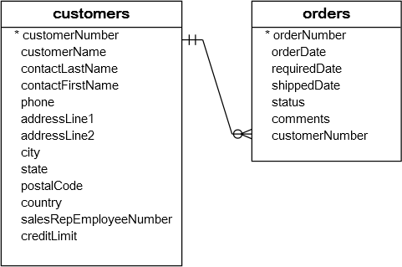
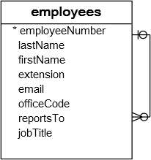
Constraints – Foreign Key
A foreign key is a field in a table that matches another field of another table. A foreign key places constraints on data in the related tables, which enables MySQL to maintain referential integrity.
The customers table is called parent table or referenced table, and the orders table is known as child table or referencing table.

Slide 353
Constraints – Foreign Key
A foreign key is a field in a table that matches another field of another table. A foreign key places constraints on data in the related tables, which enables MySQL to maintain referential integrity.
CREATE TABLE MODULE (id int ,subject varchar(1), description text, constraint pk_id_subject primary key(id, subject)) ENGINE=InnoDB;
CREATE TABLE STUDENT (id int , ModuleID int, subjectID varchar(1), address text, constraint fk_ModuleId_subjectID foreign key (ModuleID) references module(id)) ENGINE=InnoDB;
data dictionary
information_schema.table_constraints;
information_schema.key_column_usage;
information_schema.referential_constraints

Slide 354
Constraints – Foreign Key
A foreign key is a field in a table that matches another field of another table. A foreign key places constraints on data in the related tables, which enables MySQL to maintain referential integrity.
Cascaded FOREIGN KEY actions do not activate triggers.
[ON DELETE reference_option]
[ON UPDATE reference_option]
reference_option: RESTRICT | CASCADE | SET NULL | NO ACTION | SET DEFAULT
When an UPDATE or DELETE operation affects a key value in the parent table that has matching rows in the child table, the result depends on the referential action specified using ON UPDATE and ON DELETE sub clauses of the FOREIGN KEY clause.

Slide 355
Constraints – Foreign Key
CASCADE: Delete or update the row from the parent table, and automatically delete or update the matching rows in the child table. Both ON DELETE CASCADE and ON UPDATE CASCADE are supported.
SET NULL: Delete or update the row from the parent table, and set the foreign key column or columns in the child table to NULL. Both ON DELETE SET NULL and ON UPDATE SET NULL clauses are supported.
CREATE TABLE TEMP (id INT, fName varchar(10) , FOREIGN KEY (id) REFERENCES M(id) ON DELETE CASCADE) ENGINE=InnoDB;
CREATE TABLE TEMP (id INT, fName varchar(10), FOREIGN KEY (id) REFERENCES M(id) ON UPDATE CASCADE) ENGINE=InnoDB;
ALTER table E drop foreign key e_ibfk_1;
ON DELETE or ON UPDATE that is not specified, the default action is always RESTRICT.

Slide 356
What is the meaning of
Check Constraint?

Slide 357
Constraints – Check
Unfortunately, MySQL does not support CHECK constraint. Actually, MySQL accepts the CHECK clause in the CREATE TABLE statement but it ignores it silently.

Slide 358
Views

Slide 359
View
A VIEW is a logical representation of one or more tables. A VIEW contains no data itself. The tables upon which a VIEW is based are called base tables.
If a view is defined as SELECT * on a table, new columns added to the table later do not become part of the VIEW, and columns dropped from the table will result in an error when selecting from the VIEW.
A view must have unique column names with no duplicates, just like a base table. By default, the names of the columns retrieved by the SELECT statement are used for the VIEW column names.
The definition cannot refer to a TEMPORARY table, and you cannot create a TEMPORARY VIEW.
You cannot associate a TRIGGER with a VIEW.
If we drop the base table, the VIEW will not be dropped.

Slide 360
View
Views are not updatable in the following cases:
A table in the FROM clause is reference by a subquery in the WHERE statement.
There is a subquery in the SELECT clause.
The SQL statement defining the view joins tables.
One of the tables in the FROM clause is a non-updatable view.
The SELECT statement of the view contains an aggregate function such as SUM(), COUNT(), MAX(), MIN(), and so on.
The keywords DISTINCT, GROUP BY, HAVING, UNION, or UNION ALL appear in the defining SQL statement.

Slide 361
Create View
The select_statement is a SELECT statement that provides the definition of the view. The select_statement can select from base tables or other views.
CREATE [OR REPLACE]
VIEW view_name [(column_list)]
AS select_statement
[WITH CHECK OPTION]
UPDATE AND DELETE on VIEW (with check option given on view) will work only when the DATA MATCHES IN WHERE CLAUSE.
CREATE VIEW V1 as SELECT * from DEPT;
CREATE or REPLACE VIEW V1 as SELECT * from DEPT with CHECK OPTION;
desc INFORMATION_SCHEMA.VIEWS;

Slide 362
SHOW CREATE VIEW Syntax
SHOW CREATE VIEW view_name
show create view v1;
SHOW [FULL] TABLES [{FROM | IN} db_name]
[LIKE 'pattern' | WHERE expr]
show full tables where table_type like 'VIEW';

Slide 363
Alter / Drop View
This statement changes the definition of a view, which must exist.
ALTER VIEW view_name [(column_list)]
AS select_statement
[WITH CHECK OPTION]
DROP VIEW removes one or more views.
DROP VIEW [IF EXISTS]
view_name [, view_name] ...

Slide 364
MySQL indexes (PRIMARY KEY, UNIQUE, INDEX, and FULLTEXT) are stored in B-trees. FULLTEXT indexes are created on text-based columns (CHAR, VARCHAR, or TEXT columns) to help speed up queries and DML operations on data contained within those columns, omitting any words that are defined as stopwords.
Index

Slide 365
Index
Indexes are used to find rows with specific column values quickly. Without an index, MySQL must begin with the first row and then read through the entire table to find the relevant rows. If the table has an index for the columns in question, MySQL can quickly determine the position to seek to in the middle of the data file without having to look at all the data. This is much faster than reading every row sequentially.
To find the rows matching a WHERE clause quickly.
If the table has a multiple-column index, any leftmost prefix of the index can be used by the optimizer to look up rows. For example, if you have a three-column index on (col1, col2, col3), you have indexed search capabilities on (col1), (col1, col2), and (col1, col2, col3).
If we drop the base table, the INDEX will be dropped automatically.

Slide 366
Create Index
Indexes are used to find rows with specific column values quickly.
CREATE [UNIQUE] INDEX index_name
ON tbl_name (index_col_name,...)
CREATE INDEX IND1 ON EMP (ename)
CREATE UNIQUE INDEX IND1 ON EMP (ename)

Slide 367
SHOW INDEX Syntax
SHOW {INDEX | INDEXES | KEYS}
{FROM | IN} tbl_name
[{FROM | IN} db_name]
[WHERE expr]
SHOW INDEX FROM EMP;
SELECT table_name, index_name from INFORMATION_SCHEMA.STATISTICS;
SHOW INDEX returns table index information.

Slide 368
Drop Index
DROP INDEX drops the index named index_name from the table tbl_name.
DROP INDEX index_name ON tbl_name
DROP INDEX IND1 ON EMPLOYEE;

Slide 369
DATA DICTIONARY

Slide 370
DATA DICTIONARY - INFORMATION_SCHEMA
INFORMATION_SCHEMA provides access to database metadata, information about the MySQL server such as the name of a database or table, the data type of a column, or access privileges.
INFORMATION_SCHEMA is a database within each MySQL instance, the place that stores information about all the other databases that the MySQL server maintains. The INFORMATION_SCHEMA database contains several read-only tables, you can only read the contents of tables, not perform INSERT, UPDATE, or DELETE operations on them, and you cannot set triggers on them.

Slide 371
DATA DICTIONARY - INFORMATION_SCHEMA
Data Dictionary
INFORMATION_SCHEMA.COLUMNS
INFORMATION_SCHEMA.TABLES
INFORMATION_SCHEMA.TABLE_CONSTRAINTS
INFORMATION_SCHEMA.STATISTICS
INFORMATION_SCHEMA.KEY_COLUMN_USAGE
INFORMATION_SCHEMA.ROUTINES
INFORMATION_SCHEMA.PARAMETERS
INFORMATION_SCHEMA.TRIGGERS

Slide 372
Class Room
Session 1

Slide 373
PL/SQL
PL/SQL is a procedural language extension to Structured Query Language (SQL). The purpose of PL/SQL is to combine database language and procedural programming language.

Slide 374
CREATE PROCEDURE and CREATE FUNCTION

Slide 375
Stored Procedure and Function
These statements create stored routines. By default, a routine is associated with the default database. To associate the routine explicitly with a given database, specify the name as db_name.sp_name when you create it.
desc mysql.proc
CREATE PROCEDURE sp_name ([proc_parameter[,...]])
proc_parameter:
[ IN | OUT | INOUT ] param_name type
CREATE FUNCTION sp_name ([func_parameter[,...]])
RETURNS type
SELECT * FROM information_schema.parameters
WHERE SPECIFIC_NAME = 'pro1';
DROP PROCEDURE IF EXISTS MyProcedure;
delimiter $$
CREATE PROCEDURE MyProcedure()
begin
SELECT 'Infoway Technologies, Pune';
end $$
delimiter ;

Slide 376
A parameter is a variable in a method definition. When a method is called, the arguments are the data you pass into the method's parameters. Parameter is variable in the declaration of function. Argument is the actual value of this variable that gets passed to function.
Difference between arguments and parameters?
Parameter is variable in the declaration of procedure or a function.
Argument is the actual value of this variable that gets passed to a procedure or a function.

Slide 377
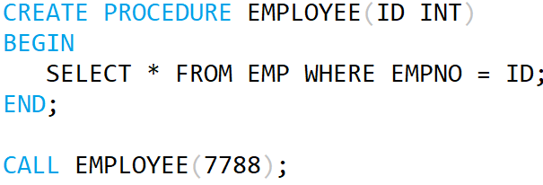
Stored Procedure and Function
Parameter List
Argument List

Slide 378
Difference between Stored Procedure and Function?

Slide 379
Stored Procedure and Function
A FUNCTION always returns a value using the return statement. PROCEDURE may return one or more values through OUT parameter(s) or may not return any at all.
Functions are normally used for computations where as procedures are normally used for executing business logic.
A Function returns 1 value only. Procedure can return multiple values (max 1024).
A function can be called directly by SQL statement like select func_name from dual while procedures cannot.
The major difference is that UDFs can be used like any other expression within SQL statements, whereas stored procedures must be invoked using the CALL statement.

Slide 380
Calling Procedure from Function and contrariwise
drop FUNCTION if exists F1;
delimiter $$
create FUNCTION F1() returns varchar(100)
begin
declare x varchar(100) default 'Hello World';
# select "Hello World";
call p1(x);
return x;
end$$
delimiter ;
drop PROCEDURE if exists P1;
delimiter $$
create PROCEDURE P1(out para1 varchar(100))
begin
# select "Hello World123";
select "Hello World123" into para1;
end$$
delimiter ;
// ERROR 1415 (0A000): Not allowed to
return a result set from a function
// ERROR 1415 (0A000): Not allowed to
return a result set from a function
This will work

Slide 381
SOURCE and CALL Stored Procedure

Slide 382
SOURCE and CALL Stored Procedure
If you are already running mysql, you can execute an SQL script file using the source command or \. command
source file_name.sql
\. file_name.sql
MySQL> source pl1.sql;
MySQL> \. file_name.sql;
The CALL statement invokes a stored procedure that was defined previously with CREATE PROCEDURE. Stored procedures that take no arguments can be invoked without parentheses. That is, CALL sp_name and CALL sp_name() are equivalent.
CALL sp_name([parameter[,...]])
CALL sp_name[()]
MySQL> call sp_name;
MySQL> call sp_name();

Slide 383
By default, mysql itself recognizes the semicolon as a statement delimiter, so you must redefine the delimiter temporarily to cause mysql to pass the entire stored program definition to the server. To redefine the mysql delimiter, use the delimiter command.
DELIMITER - Statement

Slide 384
A compound statement is a block that can contain other blocks; declarations for variables, condition handlers, and cursors; and flow control constructs such as loops and conditional tests.
BEGIN ... END Compound-Statement

Slide 385
BEGIN ... END
BEGIN ... END syntax is used for writing compound statements, which can appear within stored programs (stored procedures and functions, triggers, and events). A compound statement can contain multiple statements, enclosed by the BEGIN and END keywords. statement_list represents a list of one or more statements, each terminated by a semicolon (;) statement delimiter. The statement_list itself is optional, so the empty compound statement (BEGIN END) is legal.
[begin_label:] BEGIN
[statement_list]
END [end_label]

Slide 386
Declaring variables
DECLARE variable_name datatype(size) DEFAULT default_value;
Assigning variables
DECLARE is permitted only inside a BEGIN ... END compound statement and must be at its start, before any other statements.
1 2 | DECLARE z INT DEFAULT 0; SET z = 10;
DECLARE VARIABLES
First, you specify the variable name after the DECLARE keyword. The variable name must follow the naming rules of MySQL table column names.
Second, you specify the data type of the variable and its size. A variable can have any MySQL data types such as INT, VARCHAR , and DATETIME.
Third, when you declare a variable, its initial value is NULL. You can assign the variable a default value using the DEFAULT keyword.

Slide 387
Local Variable DECLARE and User-Defined Variables
Local variables are declared within stored procedures and are only valid within the BEGIN…END block where they are declared. Local variables can have any SQL data type.
DECLARE var_name [, var_name] ... type [DEFAULT value]
User variables in MySQL stored procedures, user variables are referenced with an ampersand (@) prefixed to the user variable name.
SET @var_name = expr [, @var_name = expr] ...
DROP PROCEDURE IF EXISTS MyProcedure;
delimiter $$
CREATE PROCEDURE MyProcedure()
beginLabel: begin
declare x varchar(12) default 'Infoway';
SELECT x;
end beginLabel $$
delimiter ;
DROP PROCEDURE IF EXISTS MyProcedure;
delimiter $$
CREATE PROCEDURE MyProcedure()
beginLabel: begin
set @x = 'Infoway';
SELECT @x;
end beginLabel $$
delimiter ;

Slide 388
Local Variable DECLARE
Local variables are declared within stored procedures and are only valid within the BEGIN…END block where they are declared. Local variables can have any SQL data type.
DECLARE var_name [, var_name] ... type [DEFAULT value]
drop procedure if exists procedureName;
delimiter $
create procedure procedureName()
begin
declare x varchar(20);
set x = 'Hello World;
SELECT x;
end$
delimiter ;

Slide 389
Local Variable DECLARE
drop procedure if exists pl1;
DELIMITER $$
CREATE PROCEDURE pl1()
BEGIN
DECLARE a INT DEFAULT 10;
DECLARE b, c INT;
SET a = a + 100;
SET b = 2;
SET c = a + b;
BEGIN
DECLARE c INT;
SET c = 5;
SELECT a, b, c;
END;
SELECT a, b, c;
END$$
DELIMITER ;

Slide 390
A procedure is a group of PL/SQL statements that you can call by name.
Stored Procedure
It is not permitted to assign the value DEFAULT to stored procedure or function parameters or stored program local variables (for example with a SET var_name = DEFAULT statement).

Slide 391
Stored Procedure - Examples
DROP PROCEDURE if EXISTS procedureName;
delimiter $$
CREATE PROCEDURE procedureName()
beginLabel: begin
SELECT * from EMP;
end beginLabel$$
delimiter ;
DROP PROCEDURE if EXISTS procedureName;
delimiter $$
CREATE PROCEDURE procedureName()
beginLabel: begin
declare x varchar(12);
SELECT ename into x from EMP where empno=7788;
SELECT x;
end beginLabel$$
delimiter ;

Slide 392
Stored Procedure - Examples
DROP PROCEDURE if EXISTS procedureName;
delimiter $$
CREATE PROCEDURE procedureName(in para1 int)
beginLabel: begin
declare x varchar(12);
SELECT ename into x from EMP where empno= para1;
SELECT x;
end beginLabel$$
delimiter ;
DROP PROCEDURE if EXISTS procedureName;
delimiter $$
CREATE PROCEDURE procedureName(in para1 varchar(15))
beginLabel: begin
declare x varchar(12);
SELECT job into x from EMP where ename= para1;
SELECT x;
end beginLabel$$
delimiter ;

Slide 393
Stored Procedure - Examples
DROP PROCEDURE procedureName;
delimiter $$
CREATE PROCEDURE procedureName(para1 varchar(12))
beginLabel: begin
SELECT * from EMP where job=para1;
end beginLabel $$
delimiter ;
DROP PROCEDURE procedureName;
delimiter $$
CREATE PROCEDURE procedureName(para1 varchar(12), out s int, out j varchar(12))
beginLabel: begin
SELECT para1, sum(Sal) into varJob, varSumSal from EMP where job=para1;
end beginLabel $$
delimiter ;

Slide 394
Stored Procedure - Examples
DROP PROCEDURE procedureName;
delimiter $$
CREATE PROCEDURE procedureName(in p1 int(2), in p2 varchar(12), in p3 varchar(10), in p4 varchar(20))
beginLabel: begin
INSERT into DEPT values (p1, p2, p3, p4);
end beginLabel $$
delimiter ;
DROP PROCEDURE procedureName;
delimiter $$
CREATE PROCEDURE MyProcedure (inout p1 int(2))
beginLabel: begin
set p1 = p1+2;
end beginLabel $$
delimiter ;
mysql> SET @x = 10
mysql> CALL procudeureName(@x);
mysql> SELECT @x

Slide 395
Stored Procedure - Examples
drop procedure if exists procedureName;
delimiter $
CREATE procedure procedureName()
begin
CREATE table TEMP (col1 int);
end$
delimiter ;
drop procedure if exists procedureName;
delimiter $
create procedure procedureName(v1 int, v2 varchar(20), v3 varchar(20), v4 varchar(20))
begin
INSERT into DEPT values (v1, v2, v3, v4);
end$
delimiter ;
drop procedure if exists pro1;
delimiter $
CREATE PROCEDURE pro1(IN var1 INT)
BEGIN
SELECT * FROM emp LIMIT var1;
END$
delimiter ;

Slide 396
Stored Procedure - Examples
drop procedure if exists procedureName;
delimiter $
create procedure procedureName()
begin
create table TEMP (col1 int);
end$
delimiter ;
drop procedure if exists procedureName;
delimiter $
create procedure procedureName(in x int, in y int, out z int, out z1 int )
begin
SET z = x + y;
SET z1 = x * y;
end$
delimiter ;
-----------------------------------------------------------------------------------------------
mysql> SET @a := 0;
mysql> SET @b := 0;
mysql> CALL pro1(5, 4, @a, @b);

Slide 397
DELIMITER PROBLEM
drop procedure if exists p1;
delimiter $$
CREATE PROCEDURE p1(out para1 varchar(100))
begin
select "Hello World123 into para1;
end$$
delimiter ;

Slide 398
IF and LOOP Label

Slide 399
IF and LOOP
IF search_condition THEN statement_list
[ELSEIF search_condition THEN statement_list] ...
[ELSE statement_list]
END IF
ITERATE means "start the loop again."
LEAVE statement is used to exit the flow control construct that has the given label.
[begin_label:] LOOP
statement_list
END LOOP [end_label]
ITERATE label
LEAVE label

Slide 400
IF and LOOP - Example
DROP PROCEDURE if EXISTS procedureName;
delimiter $$
CREATE PROCEDURE procedureName()
beginLabel: begin
declare x int;
set x:= 100;
loopLabel: loop
IF x<=110 then
set x := x + 1;
SELECT x;
ITERATE loopLabel;
ELSE
LEAVE loopLabel;
END IF;
end loop loopLabel;
end beginLabel$$
delimiter ;

Slide 401
CURSOR
Cursor declarations must appear before handler declarations. Variable and condition declarations must appear before cursor or handler declarations.

Slide 402
Cursor
This statement declares a cursor and associates it with a SELECT statement that retrieves the rows to be traversed by the cursor.
DECLARE cursor_name CURSOR FOR select_statement
This statement opens a previously declared cursor.
OPEN cursor_name
This statement fetches the next row for the SELECT statement associated with the specified cursor (which must be open), and advances the cursor pointer. If a row exists, the fetched columns are stored in the named variables. The number of columns retrieved by the SELECT statement must match the number of output variables specified in the FETCH statement.
FETCH [[NEXT] FROM] cursor_name INTO var_name [, var_name] ...
If no more rows are available, a No Data condition.
This statement closes a previously opened cursor.
CLOSE cursor_name

Slide 403
Cursor
DROP PROCEDURE if EXISTS procedureName;
delimiter $$
CREATE PROCEDURE procedureName para1 varchar(25))
beginLabel: begin
declare done TINYINT DEFAULT FALSE;
declare varEMPNO int;
declare varENAME varchar(20);
declare c1 cursor for SELECT empno, ename from EMP where job = para1;
declare exit handler for NOT FOUND set done=true;
OPEN c1;
loopLabel: loop
FETCH c1 into varEMPNO, varENAME;
IF done then
leave loopLabel;
ELSE
select varEMPNO as "Employee No.", varENAME as "Employee Name";
END IF;
end loop loopLabel;
CLOSE c1;
end beginLabel$$
delimiter ;

Slide 404
EXCEPTION / SIGNAL

Slide 405
Exception / Signal
DROP PROCEDURE IF EXISTS procedureName;
delimiter $
CREATE PROCEDURE procedureName()
begin
DECLARE a INT DEFAULT 101;
DECLARE myException CONDITION FOR SQLSTATE '45000';
/* DECLARE EXIT HANDLER FOR 1146 SELECT 'table not found';
DECLARE EXIT HANDLER FOR 1064
*/
IF a = 10 then
SELECT 'ok';
ELSE
SIGNAL myException
SET MESSAGE_TEXT = 'bad';
END IF;
end $
delimiter ;

Slide 406
First, you specify the name of the stored function after CREATE FUNCTION clause. Second, you list all parameters of the stored function inside the parentheses.
By default, all parameters are IN parameters. You cannot specify IN , OUT or INOUT modifiers to the parameters.
FUNCTIONS
The RETURNS clause may be specified only for a FUNCTION, for which it is mandatory. It indicates the return type of the function, and the function body must contain a RETURN value statement.
Note: ERROR 1415 (0A000): Not allowed to return a result set from a function
SELECT "Hello World"; // will not work in FUNCTION
SELECT "Hello World" into x; // will work in FUNCTION

Slide 407
User Defined Function - Examples
DROP FUNCTION functionName;
delimiter $$
CREATE FUNCTION functionName() RETURNS int
beginLabel: begin
declare x int;
set x = 1001;
return (x);
end beginLabel $$
delimiter ;
DROP FUNCTION functionName;
delimiter $$
CREATE FUNCTION functionName(para1 varchar(12)) RETURNS int
beginLabel: begin
declare total int default 0;
SELECT sum(sal) into total from EMP where job=para1;
return (total);
end beginLabel $$
delimiter ;

Slide 408
User Defined Function - Examples
drop function if exists functionName;
delimiter $
create function functionName() returns int
begin
declare x int;
select max(deptno) + 1 into x from dept;
return(x);
end$
delimiter ;

Slide 409
User Defined Function - Examples
drop function if exists functionName;
delimiter $
create function functionName(no int) returns varchar(20)
begin
declare x varchar(20);
select distinct 'Number present' into x from t1 where c1 = no;
if x is not null then
return(x);
else
return (no);
end if;
end$
delimiter ;

Slide 410
A trigger or database trigger is a stored program executed automatically to respond to a specific event e.g., INSERT, UPDATE or DELETE occurred in a table. The database trigger is powerful tool for protecting the integrity of the data in MySQL databases.
TRIGGERS
The trigger is always associated with the table named tbl_name, which must refer to a permanent table. You cannot associate a trigger with a TEMPORARY table or a VIEW. If you drop a table, any triggers for the table are also dropped.

Slide 411
TRIGGER
The trigger is always associated with the table named tbl_name, which must refer to a permanent table. You cannot associate a trigger with a TEMPORARY table or a VIEW.
CREATE TRIGGER trigger_name
trigger_time trigger_event
ON tbl_name FOR EACH ROW
trigger_body
trigger_time: { BEFORE | AFTER }
trigger_event: { INSERT | UPDATE | DELETE }
SHOW CREATE TRIGGER trigger_name
DESC INFORMATION_SCHEMA.TRIGGERS

Slide 412
TRIGGER
You put the trigger name after the CREATE TRIGGER statement. The trigger name should follow the naming convention [trigger time]_[table name]_[trigger event], for example before_employees_update.
Trigger activation time can be BEFORE or AFTER. You must specify the activation time when you define a trigger. You use the BEFORE keyword if you want to process action prior to the change is made on the table and AFTER if you need to process action after the change is made.
The trigger event can be INSERT, UPDATE or DELETE. This event causes the trigger to be invoked. A trigger only can be invoked by one event. To define a trigger that is invoked by multiple events, you have to define multiple triggers, one for each event.
A trigger must be associated with a specific table. Without a table trigger would not exist therefore you have to specify the table name after the ON keyword.
You place the SQL statements between BEGIN and END block. This is where you define the logic for the trigger.

Slide 413
What is trigger_time and trigger_event ?
trigger_time : trigger_time is the trigger action time. It can be BEFORE or AFTER to indicate that the trigger activates before or after each row to be modified.
trigger_event : trigger_event indicates the kind of operation that activates the trigger.
INSERT: The trigger activates whenever a new row is inserted into the table; for example, through INSERT, LOAD DATA, and REPLACE statements.
UPDATE: The trigger activates whenever a row is modified; for example, through UPDATE statements.
DELETE: The trigger activates whenever a row is deleted from the table; for example, through DELETE and REPLACE statements. DROP TABLE and TRUNCATE TABLE statements on the table do not activate this trigger, because they do not use DELETE. Dropping a partition does not activate DELETE triggers, either.

Slide 414
BEFORE and AFTER
If a BEFORE trigger fails, the operation on the corresponding row is not performed.
A BEFORE trigger is activated by the attempt to insert or modify the row or delete the row, regardless of whether the attempt subsequently succeeds.
An AFTER trigger is executed only if any BEFORE triggers and the row operation execute successfully.
An error during either a BEFORE or AFTER trigger results in failure of the entire statement that caused trigger invocation.

Slide 415
NEW and OLD
The OLD and NEW keywords enable you to access columns in the rows affected by a trigger. OLD and NEW are MySQL extensions to triggers; they are not case sensitive.
A column named with OLD is read only. In a BEFORE trigger, you can also change its value with SET NEW.col_name = value.
In an INSERT trigger, only NEW.col_name can be used; there is no OLD row.
In a DELETE trigger, only OLD.col_name can be used; there is no NEW row.
In an UPDATE trigger, you can use OLD.col_name to refer to the columns of a row before it is updated and NEW.col_name to refer to the columns of the row after it is updated.
The trigger occurs. This can either be BEFORE or AFTER an INSERT, UPDATE or DELETE. A BEFORE trigger must be used if you need to modify incoming data. An AFTER trigger must be used if you want to reference the new/changed record as a foreign key for a record in another table.
A column named with OLD is read only.

Slide 416
NOTE
The trigger cannot use the CALL statement to invoke stored procedures that return data to the client or that use dynamic SQL. (Stored procedures are permitted to return data to the trigger through OUT or INOUT parameters.)

Slide 417
DROP TRIGGER
This statement drops a trigger. The schema (database) name is optional. If the schema is omitted, the trigger is dropped from the default schema.
DROP TRIGGER [IF EXISTS] [schema_name.]trigger_name
If you drop a table, any triggers for the table are also dropped.
As of MySQL 5.7.2, it is possible to define multiple triggers for a given table that have the same trigger event and action time. For example, you can have two BEFORE UPDATE triggers for a table. By default, triggers that have the same trigger event and action time activate in the order they were created.

Slide 418
Example of trigger
drop trigger if exists triggerName;
delimiter $
create trigger triggerName before insert on dept for each row
begin
select 'Hello World';
end$
delimiter ;
ERROR 1415 (0A000): Not allowed to return a result set from a trigger

Slide 419
Example of trigger
drop trigger if exists triggerName;
delimiter $
CREATE trigger triggerName after INSERT on dept for each row
BEGIN
insert into d1 values (new.deptno, new.dname, new.loc, new.pwd);
END $
delimiter ;
drop trigger if exists triggerName;
delimiter $
CREATE trigger triggerName after UPDATE on dept for each row
BEGIN
insert into d1 values (old.dname, new.dname);
END $
delimiter ;
drop trigger if exists triggerName;
delimiter $
CREATE trigger triggerName after DELETE on dept for each row
BEGIN
insert into d values (old.deptno, old.dname, old.loc, old.pwd, now(), user());
END $
delimiter ;

Slide 420
Example of trigger
drop trigger if exists triggerName;
delimiter $
CREATE trigger triggerName after INSERT on dept for each row
BEGIN
insert into d values (new.deptno, new.dname, new.loc, new.pwd, now(), user());
END $
delimiter ;
drop trigger if exists triggerName;
delimiter $
CREATE trigger triggerName after INSERT on dept for each row
BEGIN
if DATE_FORMAT (now(), '%W') = 'Wednesday' then
signal sqlstate '42000' set message_text = 'Invalid';
end if;
END $
delimiter ;

Slide 421
Example of trigger
drop trigger if exists triggerName;
delimiter $
CREATE TRIGGER triggerName before INSERT on DEPT for each row
begin
declare msg varchar(100);
if new.dname = 'A' then
set new.dname = 'Apple';
else
set msg = 'My error message';
signal sqlstate '42000' set message_text = msg;
end if;
end $
delimiter ;

Slide 422
Example of trigger
drop trigger if exists triggerName;
delimiter $
CREATE trigger triggerName before INSERT on dept for each row
BEGIN
if new.deptno < 50 then
signal sqlstate '42000' set message_text = ‘Invalid department number';
end if;
END $
delimiter ;
drop trigger if exists triggerName;
delimiter $
CREATE TRIGGER triggerName before INSERT on EMP for each row
begin
if new.sal <=0 then
set new.sal = 25000;
end if;
end $
delimiter ;
ERROR 1362 (HY000): Updating of NEW row is not allowed in after trigger
mysql> insert into emp (empno, ename, sal, mgr, deptno) values(1, ‘ abc', -10000, 7788, 10);

Slide 423
Example of trigger
drop trigger if exists triggerName;
delimiter $
CREATE TRIGGER triggerName before INSERT on city for each row
begin
declare msg varchar(100);
if new.c1 <> 'Pune' then
set msg = 'Invalid city name';
signal sqlstate '42000' set message_text = msg;
end if;
end $
delimiter ;

Slide 424
Example of trigger
drop trigger if exists triggerName;
delimiter $
CREATE TRIGGER triggerName before INSERT on dept for
each row
begin
set new.dname = upper(new.dname);
end $
delimiter ;
mysql> insert into dept values(2, 'abc', 2, 2);

Slide 425
Example of trigger
drop trigger if exists triggerName;
delimiter $
CREATE trigger triggerName before INSERT on emp for each row
BEGIN
declare x int;
set x = (SELECT deptno from DEPT where deptno=new.deptno);
if x is null then
signal sqlstate '42000' set message_text = 'error';
end if;
END $
delimiter ;
drop trigger if exists triggerName;
delimiter $
CREATE trigger triggerName before INSERT on dept for each row
BEGIN
declare x int;
set x = (select max(deptno) + 1 from dept);
set new.deptno = x;
END $
delimiter ;

Slide 426
Database normalization, or simply normalization, is the process of organizing the columns (attributes) and tables (relations) of a relational database to reduce data redundancy and improve data integrity.
NORMALIZATION

Slide 427
STUDENT INFORMATION SYSTEM
A PROJECT ON
STUDENT MANAGEMENT SYSTEM
1st NF
Student Table
ID (PK)
TITLE
FIRSTNAME
MIDDLENAME
LASTNAME
GENDER
DOB
MATERIALSTATUS
NATIONALITY
ADDRESS
COUNTRY
STATE
DISTRICT
CITY
ZIP
LANDLINE
MOBILE
EMAILID
QUALIFICATION
HOBBIES
ACHIVEMENTS

Slide 428
STUDENT INFORMATION SYSTEM
A PROJECT ON
STUDENT MANAGEMENT SYSTEM
2nd NF
STUDENT | TITLE | GENDER | MATERIAL STATUS | NATIONALITY
ID (PK) | ID (PK) | ID (PK) | ID (PK) | ID (PK)
TITLEID (FK) | NAME | NAME | NAME | NAME
FIRSTNAME
MIDDLENAME | COUNTRY | STATE | DISTRICT | CITY | CONTACT
LASTNAME | ID (PK) | ID (PK) | ID (PK) | ID (PK) | STUDENTID(PK & FK)
GENDERID (FK) | NAME | NAME | NAME | NAME | LANDLINE
DOB |  |  |  |  | MOBILE
MATERIALSTATUSID (FK) |  |  |  |  | EMAILID
NATIONALITYID (FK)
ADDRESS | QUALIFICATION | HOBBIES | ACHIVEMENTS
STUDENTID(PK & FK) | ID (PK) | ID (PK) | ID (PK)
LINE#1 | STUDENTID(FK) | STUDENTID(FK) | STUDENTID(FK)
LINE#2 | NAME | NAME | NAME
COUNTRYID (FK) | ADDMISSIONYEAR
STATEID (FK) | INSTITUTE
DISTRICTID (FK) | UNIVERSITY
CITYID (FK) | YEAROFPASSING
ZIP | PERCENTAGE
 | GRADE

Slide 429
STUDENT INFORMATION SYSTEM
A PROJECT ON
STUDENT MANAGEMENT SYSTEM
3rd NF
STUDENT | TITLE | GENDER | MATERIAL STATUS | NATIONALITY
ID (PK) | ID (PK) | ID (PK) | ID (PK) | ID (PK)
TITLEID (FK) | NAME | NAME | NAME | NAME
FIRSTNAME
MIDDLENAME | COUNTRY | STATE | DISTRICT | CITY | CONTACT
LASTNAME | ID (PK) | ID (PK) | ID (PK) | ID (PK) | STUDENTID(PK & FK)
GENDERID (FK) | NAME | COUNTRYID (FK) | STATEID (FK) | DISTRICTID (FK) | LANDLINE
DOB |  | NAME | NAME | NAME | MOBILE
MATERIALSTATUSID (FK) |  |  |  |  | EMAILID
NATIONALITYID (FK)
ADDRESS | QUALIFICATION | HOBBIES | ACHIVEMENTS
STUDENTID(PK & FK) | ID (PK) | ID (PK) | ID (PK)
LINE#1 | STUDENTID(FK) | STUDENTID(FK) | STUDENTID(FK)
LINE#2 | NAME | NAME | NAME
CITYID (FK) | ADDMISSIONYEAR
ZIP | INSTITUTE
 | UNIVERSITY
 | YEAROFPASSING
 | PERCENTAGE
 | GRADE

Slide 430
TOUR & TRAVEL MANAGEMENT
A PROJECT ON
TOUR & TRAVEL MANAGEMENT
Modules that will be there in the projects are :
CUSTOMERS
TRAVELER
ADMIN
VISITOR

Slide 431
User Specification
Admin:- Admin can manage the user and receive package from traveller.
Traveller:- Traveller create the package and give to admin.
Customer:- Customer can view package and booking.
Visitor:- Visitor view side and give feedback.

Slide 432
User Specification
CUSTOMER
Registration (Login)
View package
Search package
Booking
Give Payment
Booking Cancellation
Give Feedback
TRAVELER
Registration (Login)
Manage tour
Manage tour package cost
Manage Bus (travels)
ADMIN
Registration (Login)
Manage User
Manage Tour-package
Manage Ticket Booking
Manage Payment
View Cancellation
View feedback
VISITOR
View site
Give feedback

Slide 433
TOUR & TRAVEL MANAGEMENT
A PROJECT ON
TOUR & TRAVEL MANAGEMENT
1st NF
TOURE
ID (PK)
NAME
TYPE
SUBTYPE
CHILDSUBTYPE
COUNTRY
SPOTS
DURATION
STARTON (DateTime)
ENDON (DateTime)
COST
FACILITY
INCLUDED
EXCLUDED
SCHEDULEDON
PORPOSE (BUSINESS, EXIBATION, MEETING)
DESCRIPTION
ITINERARY
NOTES
EXTRATOPPING
OURSPECIALITY
REPORTING AND DROPPING
TRANSPORT
HOTEL
HIGHLIGHT
POINTS
DETAILS

Slide 434
TOUR & TRAVEL MANAGEMENT
A PROJECT ON TOUR & TRAVEL MANAGEMENT
2nd NF
TOUR |  | TYPE |  | SUBTYPE |  | CHILDSUBTYPE
ID (PK) |  | ID (PK) |  | ID (PK) |  | ID (PK)
NAME |  | NAME |  | NAME |  | NAME
DURATION
DESCRIPTION
COUNTRY |  | SPOTS |  | SCHEDULE |  | FACILITY
ID (PK) |  | ID (PK) |  | ID (PK) |  | ID (PK)
NAME |  | ITINERARYID (FK) |  | TOUREID (FK) |  | TOUREID (FK)
 |  | NAME |  | STARTON (DateTime) |  | NAME
 |  |  |  | ENDON (DateTime)
 |  |  |  | COST
INCLUDED |  | EXCLUDED |  | PURPOSE
ID (PK) |  | ID (PK) |  | ID (PK)
TOUREID (FK) |  | TOUREID (FK) |  | TOUREID (FK)
NAME |  | NAME |  | NAME
ITINERARY |  | DAYWISE SCHEDULE |  | NOTES |  | EXTRATOPPING
ID (PK) |  | ID (PK) |  | ID (PK) |  | ID (PK)
TOUREID (FK) |  | ITINERARYID (FK) |  | ITINERARYID (FK) |  | ITINERARYID (FK)
VALIDFROM |  | HEADING |  | NOTES |  | EXTRATOPPINGS
VALIDTO |  | DESCRIPTION
 |  | BREAKFAST |  | OURSPECIALITY |  | REPORTING AND DROPPING
 |  | LUNCH |  | ID (PK) |  | ID (PK)
 |  | HITEA |  | ITINERARYID (FK) |  | ITINERARYID (FK)
 |  | DINNER |  | SPECIALITIES |  | DETAILS
 |  | EXTRATOPPING
TRANSPORT |  | HOTEL |  | POINTS
ID (PK) |  | ID (PK) |  | ID (PK)
TOUREID (FK) |  | TOUREID (FK) |  | SPOTID {FK}
TYPE |  | NAME |  | NAME
DESCRIPTION |  | TYPE |  | DETAILS
 |  | DESCRIPTION

Slide 435
TOUR & TRAVEL MANAGEMENT
A PROJECT ON TOUR & TRAVEL MANAGEMENT
3rd NF
TOUR |  | TYPE |  | SUBTYPE |  | CHILDSUBTYPE
ID (PK) |  | ID (PK) |  | ID (PK) |  | ID (PK)
NAME |  | NAME |  | TYPEID (FK) |  | SUBTYPEID (FK)
DURATION |  |  |  | NAME |  | NAME
DESCRIPTION
CHILDSUBTYPEID(FK)
COUNTRY |  | SPOTS |  | SCHEDULE |  | FACILITY
ID (PK) |  | ID (PK) |  | ID (PK) |  | ID (PK)
NAME |  | ITINERARYID (FK) |  | TOUREID (FK) |  | TOUREID (FK)
 |  | NAME |  | STARTON (DateTime) |  | NAME
 |  |  |  | ENDON (DateTime)
 |  |  |  | COST
INCLUDED |  | EXCLUDED |  | PURPOSE
ID (PK) |  | ID (PK) |  | ID (PK)
TOUREID (FK) |  | TOUREID (FK) |  | TOUREID (FK)
NAME |  | NAME |  | NAME
ITINERARY |  | DAYWISE SCHEDULE |  | NOTES |  | EXTRATOPPING
ID (PK) |  | ID (PK) |  | ID (PK) |  | ID (PK)
COUNTRYID(FK) |  | ITINERARYID (FK) |  | ITINERARYID (FK) |  | ITINERARYID (FK)
TOUREID (FK) |  | HEADING |  | NOTES |  | EXTRATOPPINGS
VALIDFROM |  | DESCRIPTION
VALIDTO |  | BREAKFAST |  | OURSPECIALITY |  | REPORTING AND DROPPING
 |  | LUNCH |  | ID (PK) |  | ID (PK)
 |  | HITEA |  | ITINERARYID (FK) |  | ITINERARYID (FK)
 |  | DINNER |  | SPECIALITIES |  | DETAILS
 |  | EXTRATOPPING
TRANSPORT |  | HOTEL |  | POINTS
ID (PK) |  | ID (PK) |  | ID (PK)
TOUREID (FK) |  | TOUREID (FK) |  | SPOTID {FK}
TYPE |  | NAME |  | NAME
DESCRIPTION |  | TYPE |  | DETAILS
 |  | DESCRIPTION

Slide 436
Big Data?
Big data is a term that describes the large volume of data – both structured and unstructured

Slide 437
IMP SQL statements
1. Find 2nd highest salary.
SELECT MAX(SAL) FROM EMP WHERE SAL < (SELECT MAX(SAL) FROM EMP);
2. Find 2nd lowest salary.
SELECT MIN(SAL) FROM EMP WHERE SAL > (SELECT MIN(SAL) FROM EMP);
3. Find 2nd highest salary of each department.
SELECT MAX(SAL) FROM EMP WHERE SAL NOT IN (SELECT MAX(SAL) FROM EMP GROUP BY DEPTNO) GROUP BY DEPTNO;
4. Find 2nd lowest salary of each department.
SELECT MIN(SAL) FROM EMP WHERE SAL NOT IN (SELECT MIN(SAL) FROM EMP GROUP BY DEPTNO) GROUP BY DEPTNO;

Slide 438
IMP SQL statements
TABLET Table
Id | Name | Ingredient | Unit
1 | CROCIN | PARACETAMOL | 100mg
2 | COMBIFLAM | PARACETAMOL, IBUPROFEN | 25mg
3 | DIVON PLUS | PARACETAMOL, DICLOFENAC | 30mg
SYRUP Table
Id | Name | Ingredient | Unit
11 | BENADRYL | DIPHENHYDRAMINE | .7mg
12 | COMBIFLAM | PARACETAMOL, IBUPROFEN | 0.12mg
13 | COREX | CHLORPHENAMINE | 2.3mg
14 | DICLO | DICLOFENAC | 0.06mg
INJECTION Table
Id | Name | Ingredient | Unit
21 | BRUFEN | IBUPROFEN | 0.10mg
22 | CPM | CHLORPHENAMINE | 0.25mg
23 | VOVERAN | DICLOFENAC | 0.09mg

Slide 439
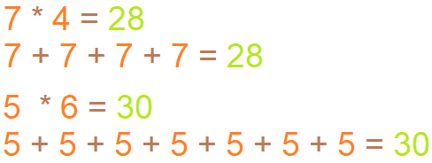
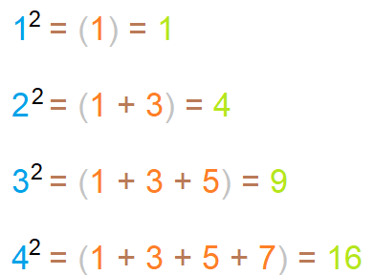
IMP
1. Think about how multiplication can be done without actually multiplying
2. Square

Slide 440


